Slide 1
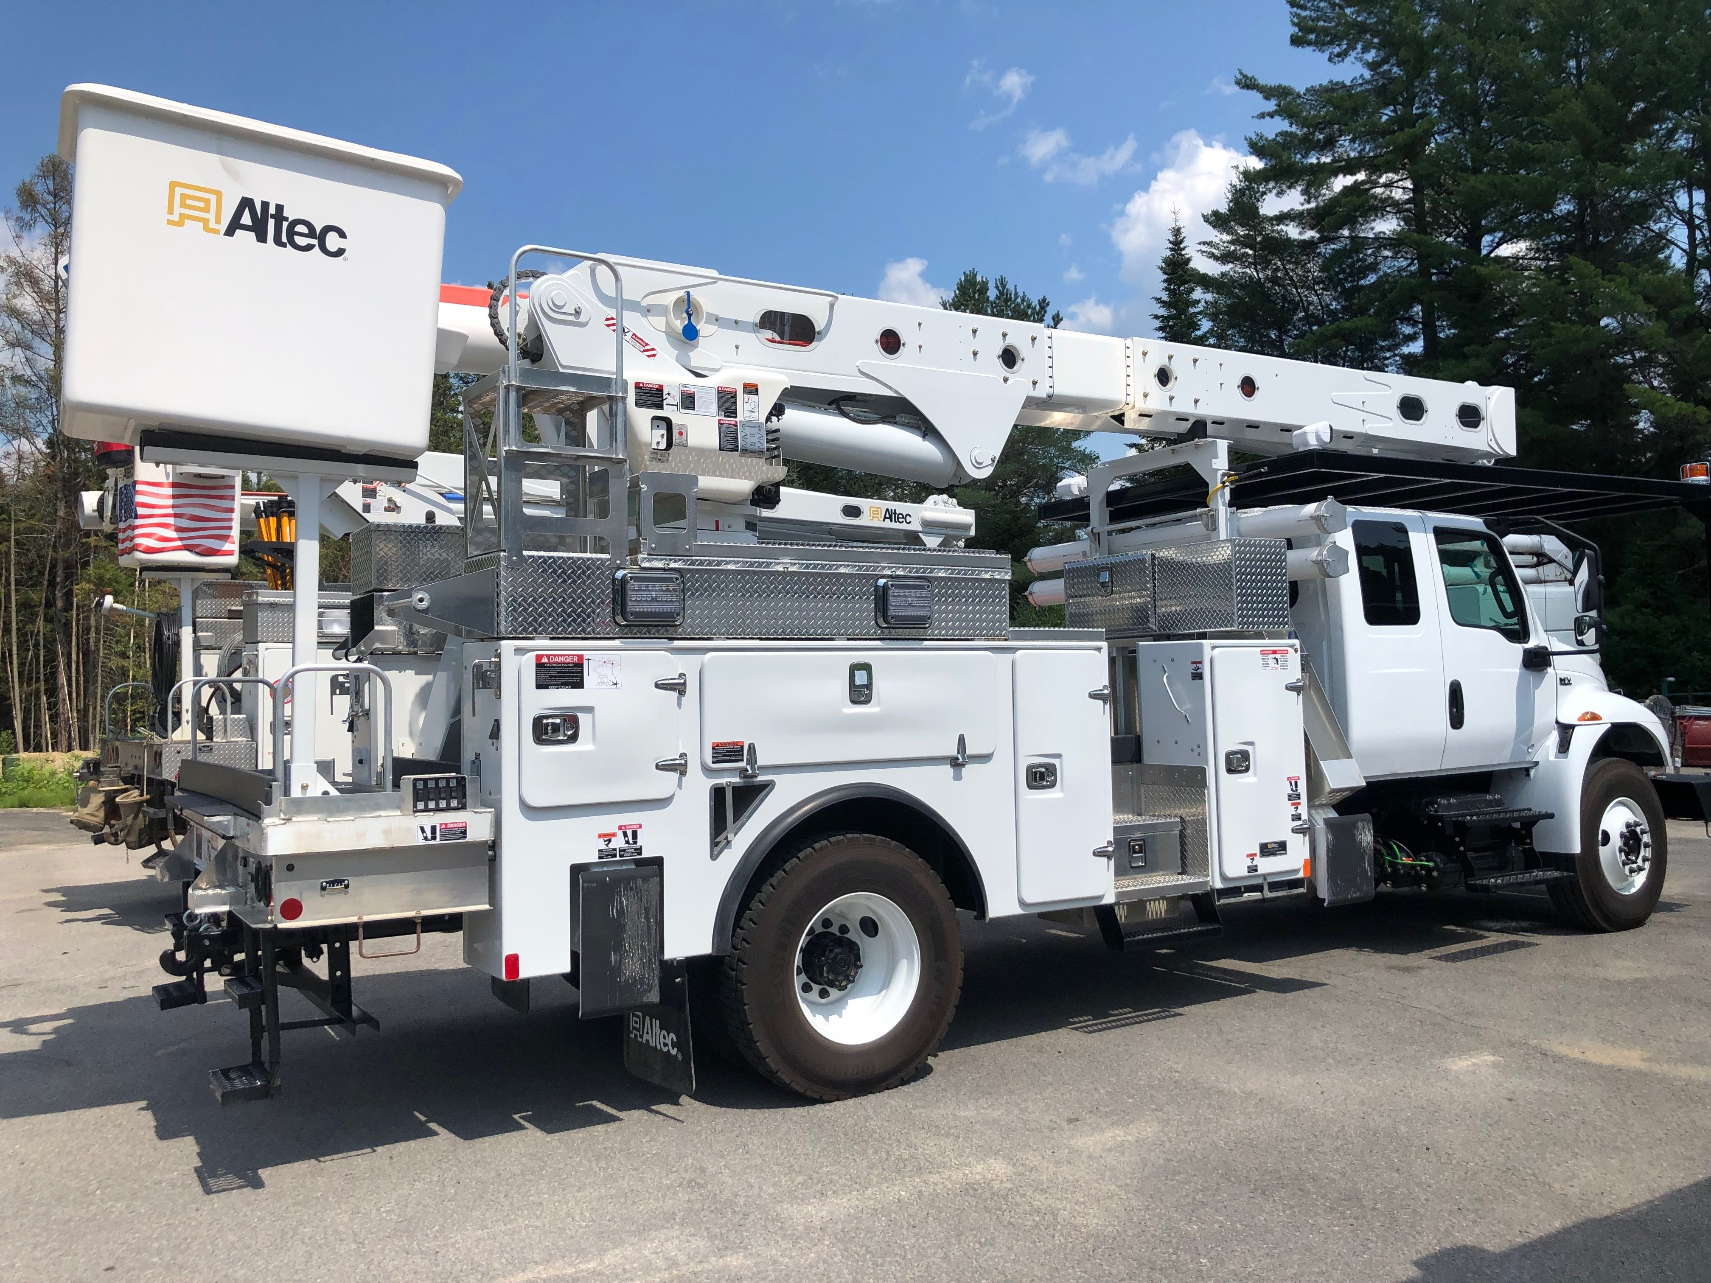
DOT Compliance For The Line Worker
Shelby Ramsey, CDS, O-RMP
Asplundh Infrastructure Group

Slide 2
Raise your hand IF…..
You’ve worked in construction for 10 years or longer.
If you’ve ever worked in the rain when you really didn’t want to.
If you’ve ever said, “That’s not my job.”
If you’ve ever blamed someone for something you totally did.
If you’ve ever hidden from your boss.
If you’ve ever pretended to understand the engineer.
If you’ve used a tool for something it definitely wasn’t meant for.
If you’ve ever looked busy because management was around.
If you’ve every been the cause of the problem everyone was trying to figure out and you just rolled with it and played along.
How many of you can actually relate to this guy………

Slide 3


Slide 4
How many truck drivers do I have in the room?
Who has a CDL?

Slide 5
Compliance, Safety, Accountability (CSA)
CSA is FMCSA's data-driven safety compliance and enforcement program designed to improve safety and prevent commercial motor vehicle (CMV) crashes, injuries, and fatalities. CSA consists of three core components; the Safety Measurement System (SMS); interventions; and a Safety Fitness Determination (SFD) rating system to determine the safety fitness of motor carriers.

Slide 6
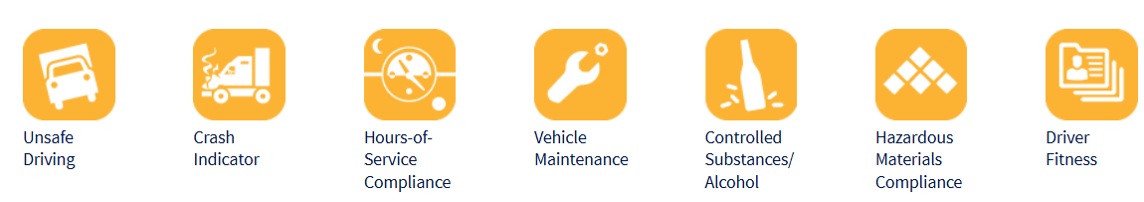
CSA BASIC Categories

Slide 7

What does “BASIC” mean
Stands for “Behavior Analysis and Safety Improvement Category – (There are 7)
Unsafe Driving, Crash Indicator, HOS, Vehicle Maintenance, Controlled Substance/Alcohol, HazMat, Driver Fitness

Slide 8
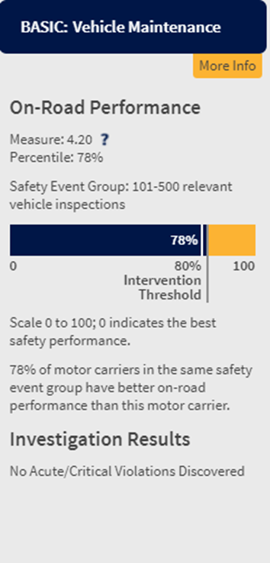
BASIC scores
BASIC categories are used to calculate a quantifiable measure of a motor carrier’s performance.
The DOT and FMCSA take all motor carriers and sort them into groups based on miles driven, number of drivers, and fleet size. We are then ranked on a scale from 0-100% using a “bell” curve. The higher the percentage, the worse we are. (Example pictured right)
They have predetermined “thresholds” that flag our company and place us in alert status.

Slide 9
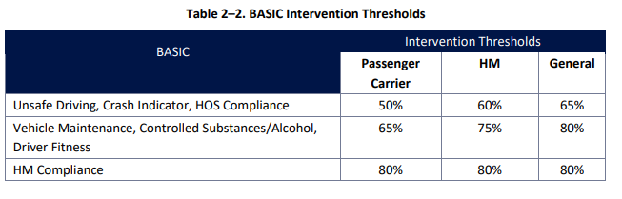
BASIC Category Intervention Thresholds
Out of Service Rate Threshold – 34%

Slide 10
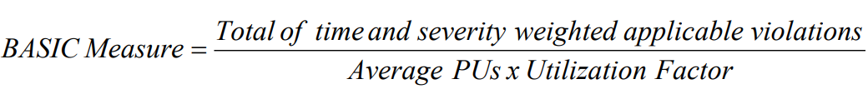
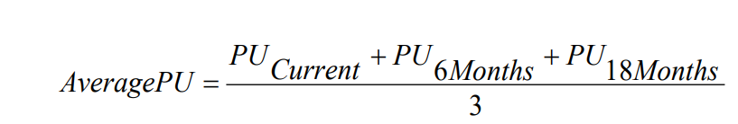
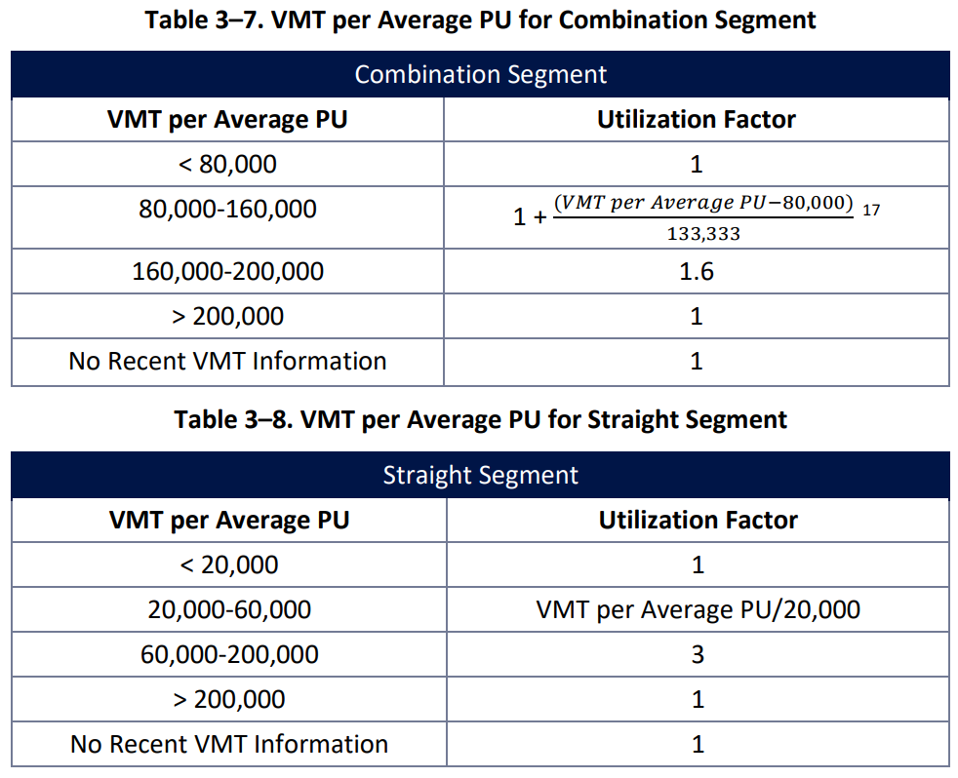
How do they get the measurement????

Slide 11
Levels of Inspection
Level 1 – Full Inspection
Level 2 – Walk – Around and Driver Documents
Level 3 – Driver Documents

Slide 12
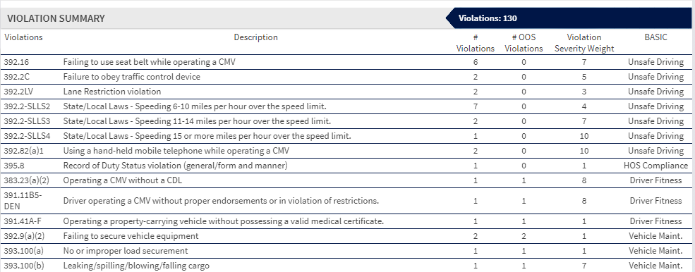
Definitions
Violation Severity – converted on a scale from 1-10 on how likely can this violation cause a crash? 10 represents the most likely. The listing can be found in Appendix A of the reserved federal regulations.

Slide 13

Time Weight – a point value of 1, 2, or 3 will be assigned to the inspection. As time progresses, the point value will decrease throughout the score life.
3 = inspection within the last 6 months
2 = inspection longer than 6 months ago but within 12 months
1 = inspection longer than 12 months ago but within 24 months.

Slide 14
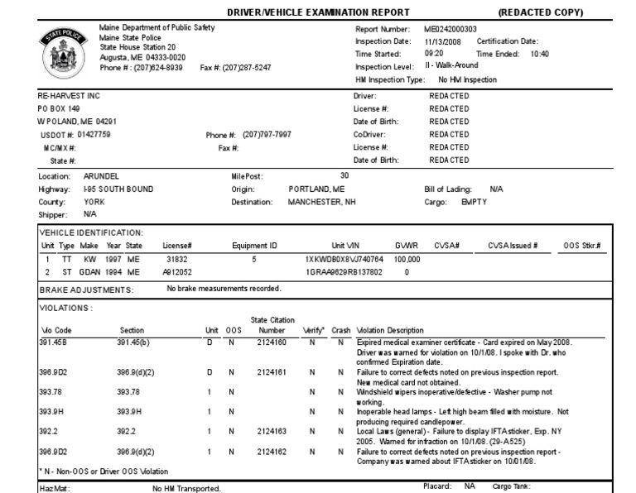

Slide 15
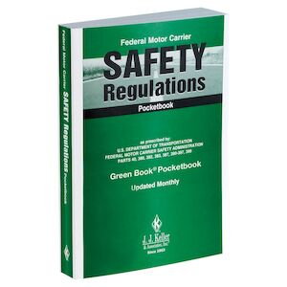
Most Common Violations – “in our industry”
49 CFR
Subtitle B
Chapter III
Subchapter B
Parts 390-396

Slide 16
Part 390 – General Safety

Slide 17
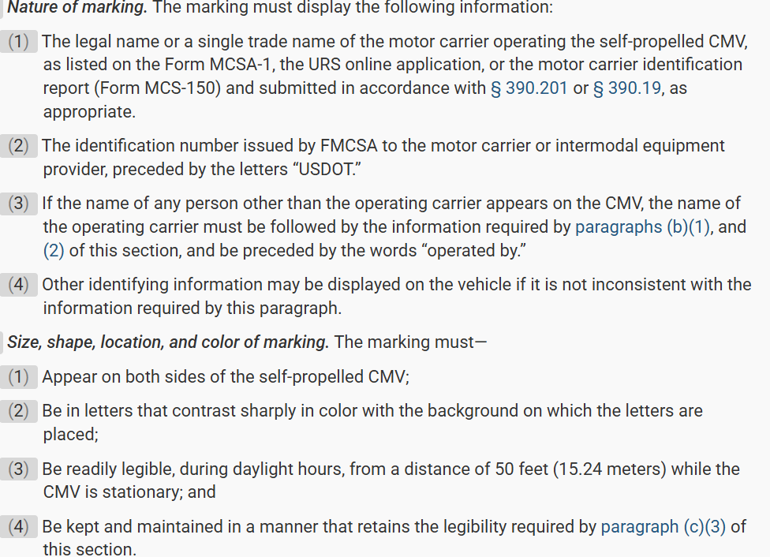
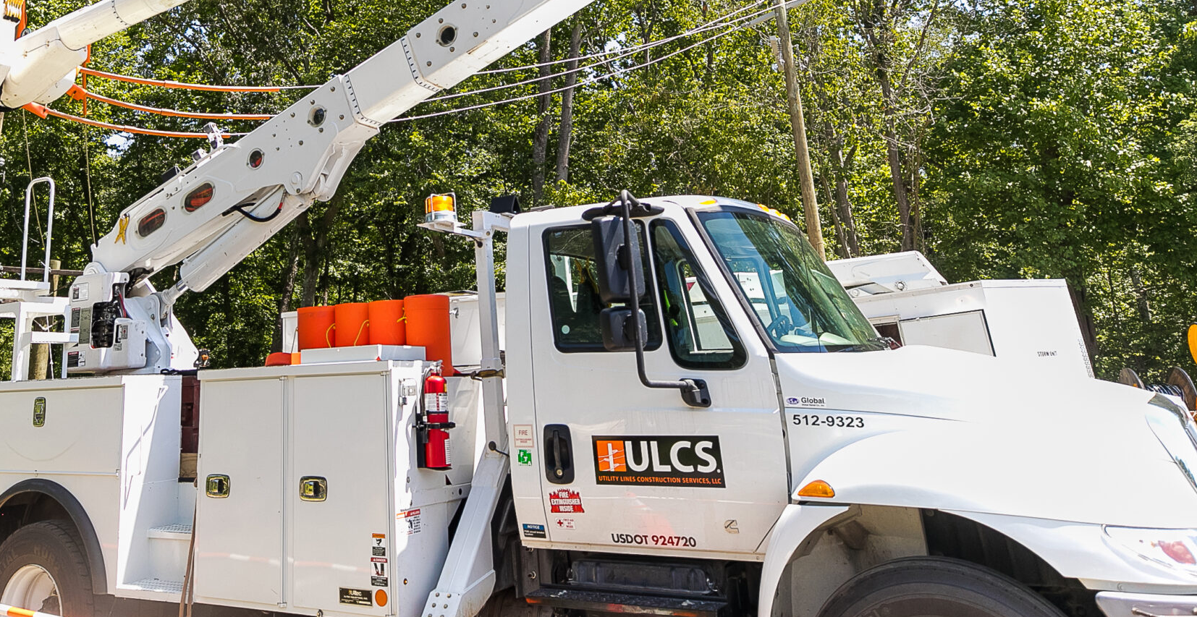
§ 390.21 Marking of self-propelled CMVs and intermodal equipment.

Slide 18

§ 390.23 Automatic relief from regulations.
(a) Presidential declaration of emergency. Parts 390 through 399 of this chapter, or any section thereof, shall not apply to any motor carrier or driver operating a commercial motor vehicle so long as the motor carrier or driver is providing direct assistance during an emergency declared by the President of the United States pursuant to 42 U.S.C. 5191(b) during the emergency period or 30 days from the date of the initial declaration of the emergency, whichever is less.
(b) Regional declarations of emergency. Except as provided in paragraph (b)(1) of this section, §§ 395.3 and 395.5 of this chapter shall not apply to a motor carrier or driver operating a commercial motor vehicle so long as the motor carrier or driver is providing direct assistance during an emergency declared by the Governor of a State, their authorized representative, or FMCSA during the emergency period or 14 days from the date of the initial declaration of emergency, whichever is less

Slide 19
Part 391 – Driver Qualification

Slide 20

§ 391.11 General qualifications of drivers.
(a) A person shall not drive a commercial motor vehicle unless he/she is qualified to drive a commercial motor vehicle. Except as provided in § 391.63, a motor carrier shall not require or permit a person to drive a commercial motor vehicle unless that person is qualified to drive a commercial motor vehicle.
(b) Except as provided in subpart G of this part, a person is qualified to drive a motor vehicle if he/she—
(1) Is at least 21 years old;
(2) Can read and speak the English language sufficiently to converse with the general public, to understand highway traffic signs and signals in the English language, to respond to official inquiries, and to make entries on reports and records;
(3) Can, by reason of experience, training, or both, safely operate the type of commercial motor vehicle he/she drives;
(4) Is physically qualified to drive a commercial motor vehicle in accordance with subpart E—Physical Qualifications and Examinations of this part;
(5) Has a currently valid commercial motor vehicle operator's license issued only by one State or jurisdiction;
(6) Is not disqualified to drive a commercial motor vehicle under the rules in § 391.15; and
(7) Has successfully completed a driver's road test and has been issued a certificate of driver's road test in accordance with § 391.31, or has presented an operator's license or a certificate of road test which the motor carrier that employs him/her has accepted as equivalent to a road test in accordance with § 391.33.

Slide 21
Part 392 – Driving of a Commercial Motor Vehicle

Slide 22

§ 392.3 Ill or fatigued operator.
No driver shall operate a commercial motor vehicle, and a motor carrier shall not require or permit a driver to operate a commercial motor vehicle, while the driver's ability or alertness is so impaired, or so likely to become impaired, through fatigue, illness, or any other cause, as to make it unsafe for him/her to begin or continue to operate the commercial motor vehicle. However, in a case of grave emergency where the hazard to occupants of the commercial motor vehicle or other users of the highway would be increased by compliance with this section, the driver may continue to operate the commercial motor vehicle to the nearest place at which that hazard is removed.

Slide 23
§ 392.5 Alcohol prohibition.
(a) No driver shall—
(1) Use alcohol, as defined in § 382.107 of this subchapter, or be under the influence of alcohol, within 4 hours before going on duty or operating, or having physical control of, a commercial motor vehicle; or
(2) Use alcohol, be under the influence of alcohol, or have any measured alcohol concentration or detected presence of alcohol, while on duty, or operating, or in physical control of a commercial motor vehicle; or
(3) Be on duty or operate a commercial motor vehicle while the driver possesses wine of not less than one-half of one per centum of alcohol by volume, beer as defined in 26 U.S.C. 5052(a), of the Internal Revenue Code of 1954, or distilled spirits as defined in section 5002(a)(8), of such Code. However, this does not apply to possession of wine, beer, or distilled spirits which are:
(i) Manifested and transported as part of a shipment; or
(ii) Possessed or used by bus passengers

Slide 24
§ 392.16 Use of seat belts.
(a) Drivers. No driver shall operate a commercial motor vehicle, and a motor carrier shall not require or permit a driver to operate a commercial motor vehicle, that has a seat belt assembly installed at the driver's seat unless the driver is properly restrained by the seat belt assembly.
(b) Passengers. No driver shall operate a property-carrying commercial motor vehicle, and a motor carrier shall not require or permit a driver to operate a property-carrying commercial motor vehicle, that has seat belt assemblies installed at the seats for other occupants of the vehicle unless all other occupants are properly restrained by such seat belt assemblies

Slide 25

§ 392.50 Ignition of fuel; prevention
No driver or any employee of a motor carrier shall:
(a) Fuel a commercial motor vehicle with the engine running, except when it is necessary to run the engine to fuel the commercial motor vehicle;
(b) Smoke or expose any open flame in the vicinity of a commercial motor vehicle being fueled;
(c) Fuel a commercial motor vehicle unless the nozzle of the fuel hose is continuously in contact with the intake pipe of the fuel tank;
(d) Permit, insofar as practicable, any other person to engage in such activities as would be likely to result in fire or explosion.

Slide 26
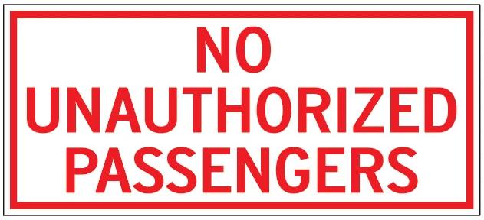
§ 392.60 Unauthorized persons not to be transported
(a) Unless specifically authorized in writing to do so by the motor carrier under whose authority the commercial motor vehicle is being operated, no driver shall transport any person or permit any person to be transported on any commercial motor vehicle other than a bus. When such authorization is issued, it shall state the name of the person to be transported, the points where the transportation is to begin and end, and the date upon which such authority expires. No written authorization, however, shall be necessary for the transportation of:
(1) Employees or other persons assigned to a commercial motor vehicle by a motor carrier;
(2) Any person transported when aid is being rendered in case of an accident or other emergency;
(3) An attendant delegated to care for livestock.
(b) This section shall not apply to the operation of commercial motor vehicles controlled and operated by any farmer and used in the transportation of agricultural commodities or products thereof from his/her farm or in the transportation of supplies to his/her farm

Slide 27
Part 393 – Parts & Accessories

Slide 28
Pre-Trip Inspection and Preparedness
Pre-Trip vs. Post-Trip: What’s the difference?
→ Pre-Trip is to be done at the BEGINNING OF SHIFT
→ Post-Trip (DVIR) is to be done at the end of shift
Maintaining equipment prevents unexpected equipment conditions that could potentially contribute to vehicle accidents.

Slide 29
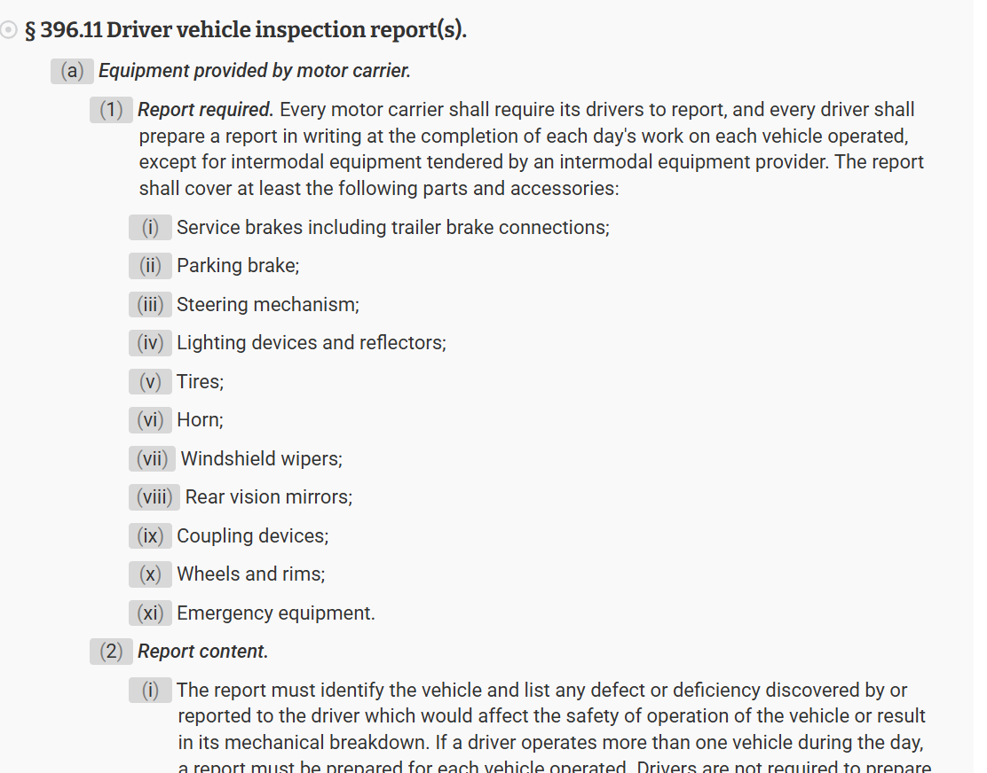

Slide 30
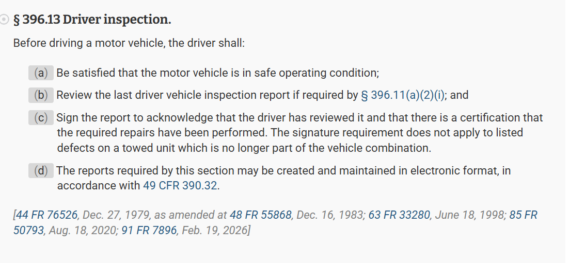

Slide 31
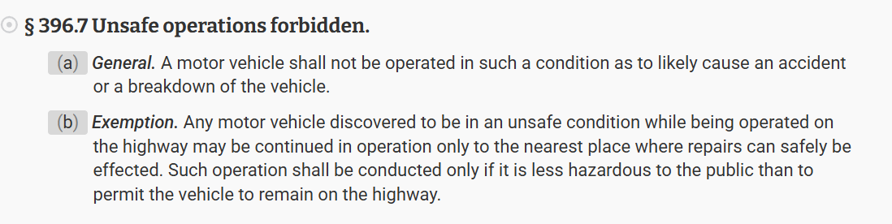

Slide 32
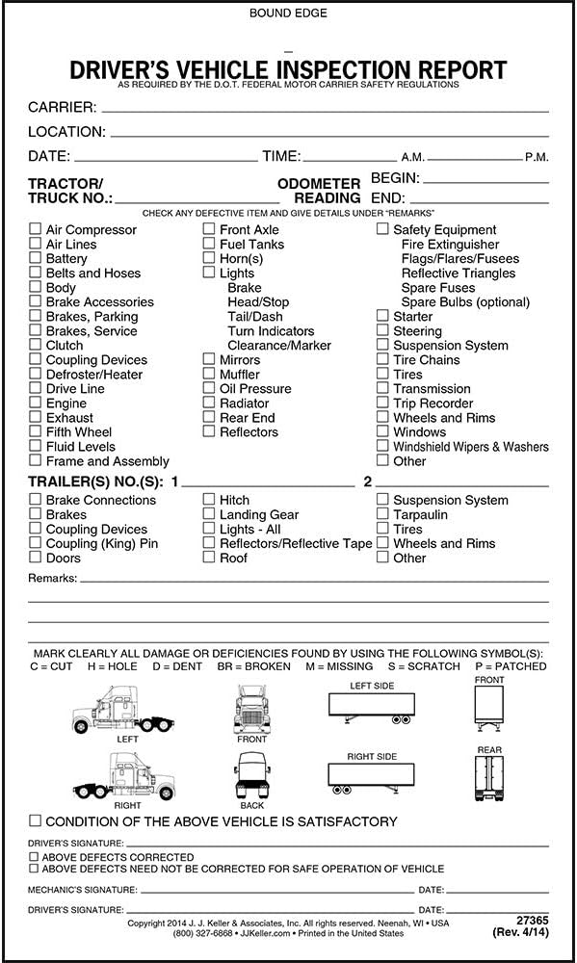

Slide 33
Pre-Trip Inspection Checklist
Drivers should be sure to carefully inspect the:
Parking brake
Service brakes and air brakes (including trailer brake if applicable)
Steering mechanism
Lighting devices and reflectors
Fluids / hoses / pumps
Tires
Horn
Windshield wiper or wipers
Rear-vision mirror or mirrors
Coupling devices if applicable
Wheels and rims
and all Emergency equipment

Slide 34
§ 393.43 Breakaway and emergency braking.
(d) Breakaway braking requirements for trailers. Every trailer required to be equipped with brakes shall have brakes which apply automatically and immediately upon breakaway from the towing vehicle. With the exception of trailers having three or more axles, all brakes with which the trailer is required to be equipped must be applied upon breakaway from the towing vehicle. The brakes must remain in the applied position for at least 15 minutes.
DEMO TIME

Slide 35
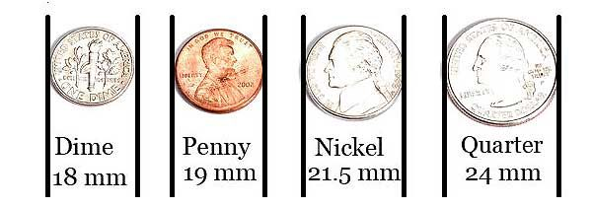
§ 393.60 Window Construction
(c) Windshield condition. With the exception of the conditions listed in paragraphs (c)(1), (c)(2), and (c)(3) of this section, each windshield shall be free of discoloration or damage in the area extending upward from the height of the top of the steering wheel (excluding a 51 mm (2 inch) border at the top of the windshield) and extending from a 25 mm (1 inch) border at each side of the windshield or windshield panel. Exceptions:
(1) Coloring or tinting which meets the requirements of paragraph (d) of this section;
(2) Any crack that is not intersected by any other cracks;
(3) Any damaged area which can be covered by a disc 19 mm (3⁄4 inch) in diameter if not closer than 76 mm (3 inches) to any other similarly damaged area.

Slide 36
§ 393.60 Window Construction
(d) Coloring or tinting of windshields and windows. Coloring or tinting of windshields and the windows to the immediate right and left of the driver is allowed, provided the parallel luminous transmittance through the colored or tinted glazing is not less than 70 percent of the light at normal incidence in those portions of the windshield or windows which are marked as having a parallel luminous transmittance of not less than 70 percent. The transmittance restriction does not apply to other windows on the commercial motor vehicle

Slide 37
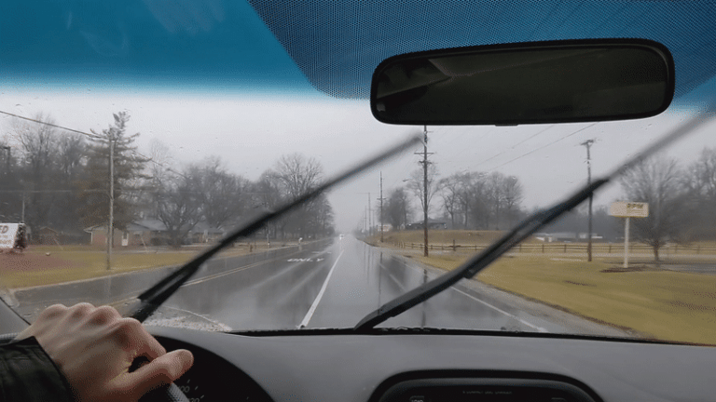
§ 393.60 Window Construction
(e) Prohibition on obstructions to the driver's field of view—
(1) Devices mounted on the interior of the windshield.
(i) Antennas, and similar devices must not be mounted more than 152 mm (6 inches) below the upper edge of the windshield. These devices must be located outside the area swept by the windshield wipers, and outside the driver's sight lines to the road and highway signs and signals.
(ii) Paragraph (e)(1)(i) of this section does not apply to vehicle safety technologies, as defined in § 393.5, that are mounted on the interior of a windshield. Devices with vehicle safety technologies must be mounted:
(A) Not more than 216 mm (8.5 inches) below the upper edge of the area swept by the windshield wipers;
(B) Not more than 175 mm (7 inches) above the lower edge of the area swept by the windshield wipers; and
(C) Outside the driver's sight lines to the road and highway signs and signals

Slide 38
§ 393.87 Warning flags on projecting loads.
(a) Any commercial motor vehicle transporting a load which extends beyond the sides by more than 102 mm (4 inches) or more than 1,219 mm (4 feet) beyond the rear must have the extremities of the load marked with red or orange fluorescent warning flags. Each warning flag must be at least 457 mm (18 inches) square.
(b) Position of flags. There must be a single flag at the extreme rear if the projecting load is two feet wide or less. Two warning flags are required if the projecting load is wider than two feet. Flags must be located to indicate maximum width of loads which extend beyond the sides and/or rear of the vehicle.

Slide 39


§ 393.94 Interior noise levels in power units.
a) Applicability of this section. The interior noise level requirements apply to all trucks, truck-tractors, and buses.
(b) General rule. The interior sound level at the driver's seating position of a motor vehicle must not exceed 90 dB(A) when measured in accordance with paragraph (c) of this section.

Slide 40
§ 393.95 Emergency equipment on all power units.
(ii) A power unit that is not used to transport hazardous materials must be equipped with either:
(A) A fire extinguisher having an Underwriters' Laboratories rating of 5 B:C or more; or
(B) Two fire extinguishers, each of which has an Underwriters' Laboratories rating of 4 B:C or more.
(4) Condition, location, and mounting. The fire extinguisher(s) must be filled and located so that it is readily accessible for use. The extinguisher(s) must be securely mounted to prevent sliding, rolling, or vertical movement relative to the motor vehicle.

Slide 41
§ 393.95 Emergency equipment on all power units.
(f) Warning devices for stopped vehicles. Except as provided in paragraph (g) of this section, one of the following options must be used:
(1) Three bidirectional emergency reflective triangles that conform to the requirements of Federal Motor Vehicle Safety Standard No. 125, § 571.125 of this title; or
(2) At least 6 fusees. The vehicle must have as many additional fusees as are necessary to satisfy the requirements of § 392.22 of this chapter.
(3) Other warning devices may be used in addition to, but not in lieu of, the required warning devices, provided those warning devices do not decrease the effectiveness of the required warning devices.

Slide 42
§ 393.104 Standards for cargo securement devices and systems.
(f) Use of tiedowns.
(1) Tiedowns and securing devices must not contain knots.
(2) If a tiedown is repaired, it must be repaired in accordance with the applicable standards in paragraph (e) of this section, or the manufacturer's instructions.
(3) Each tiedown must be attached and secured in a manner that prevents it from becoming loose, unfastening, opening or releasing while the vehicle is in transit.
(4) Edge protection must be used whenever a tiedown would be subject to abrasion or cutting at the point where it touches an article of cargo. The edge protection must resist abrasion, cutting and crushing.

Slide 43

§ 393.110 Additional requirements for determining the minimum number of tiedowns.
(a) When tiedowns are used as part of a cargo securement system, the minimum number of tiedowns required to secure an article or group of articles against movement depends on the length of the article(s) being secured, and the requirements of paragraphs (b) and (c) of this section. These requirements are in addition to the rules under § 393.106.
(b) When an article is not blocked or positioned to prevent movement in the forward direction by a headerboard, bulkhead, other cargo that is positioned to prevent movement, or other appropriate blocking devices, it must be secured by at least:
(1) One tiedown for articles 5 feet (1.52 meters) or less in length, and 1,100 pounds (500 kg) or less in weight;
(2) Two tiedowns if the article is:
(i) 5 feet (1.52 meters) or less in length and more than 1,100 pounds (500 kg) in weight; or
(ii) Longer than 5 feet (1.52 meters) but less than or equal to 10 feet (3.04 meters) in length, irrespective of the weight.
(3) Two tiedowns if the article is longer than 10 feet (3.04 meters), and one additional tiedown for every 10 feet (3.04 meters) of article length, or fraction thereof, beyond the first 10 feet (3.04 meters) of length.

Slide 44
Special Provisions
§ 393.118 Specific securement requirements for dressed lumber and similar building products.
§ 393.120 Specific securement requirements for metal coils.
§ 393.124 Specific securement requirements for concrete pipe.
§ 393.130 Specific securement requirements for heavy vehicles, equipment, and machinery.

Slide 45
Part 395 – Hours of Service

Slide 46
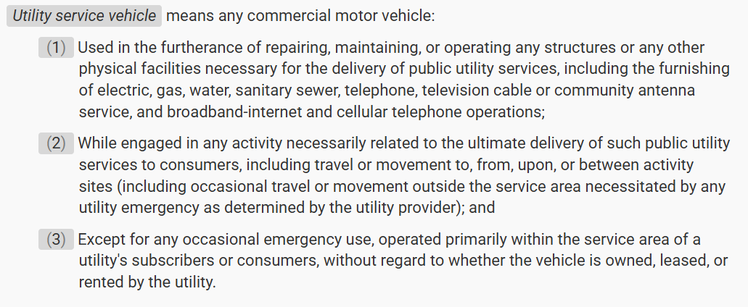
Utility Service Vehicle - definition

Slide 47
Part 396 – Inspections

Slide 48
Types of Inspections
Pre-Trip
Post-Trip / DVIR
Roadside
Annual
En Route

Slide 49

Pre-Trip TRIVIA

Slide 50
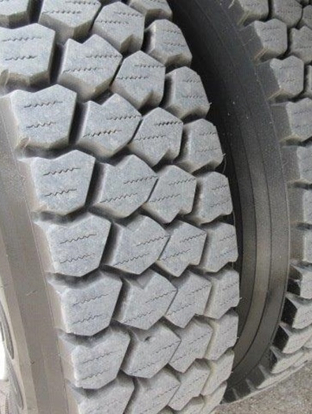
What is the minimum tread depth for the FRONT tire?
4/32

Slide 51
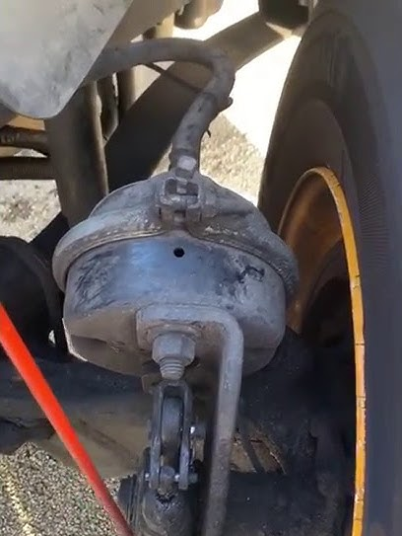
Fill in the blank….
Should be no more than __________
with the brakes released.
1 inch

Slide 52
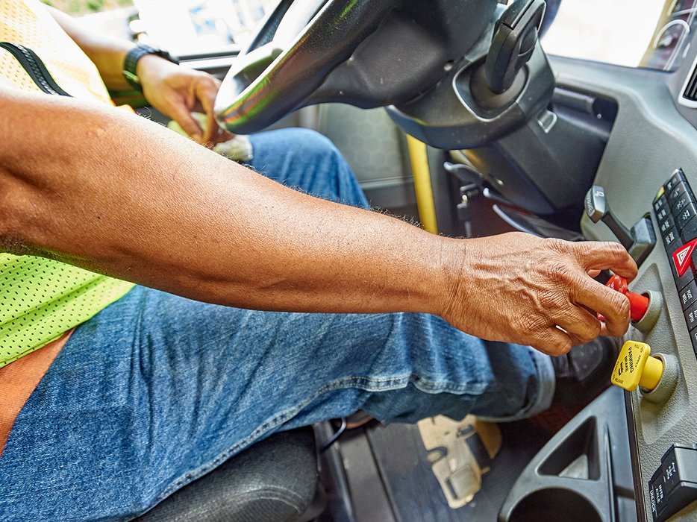
What is the first step of the air brake check after the parking brake is released?
Static brake hold

Slide 53
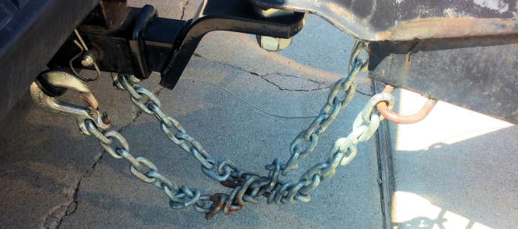
True or False
You can twist the chains if you need to shorten them to prevent excess slack.
FALSE

Slide 54
Which vehicle maintenance violation is an OUT OF SERVICE violation?
A: Turn Signal not working properly on the trailer.
B: Windshield has a quarter-sized “ding” on the passenger’s side
C: Trailer tire with a max rating of 110psi is inflated to 50psi
D: Brake away cable wrapped through the chain and connected to the truck d-ring.
E: All of the above

Slide 55
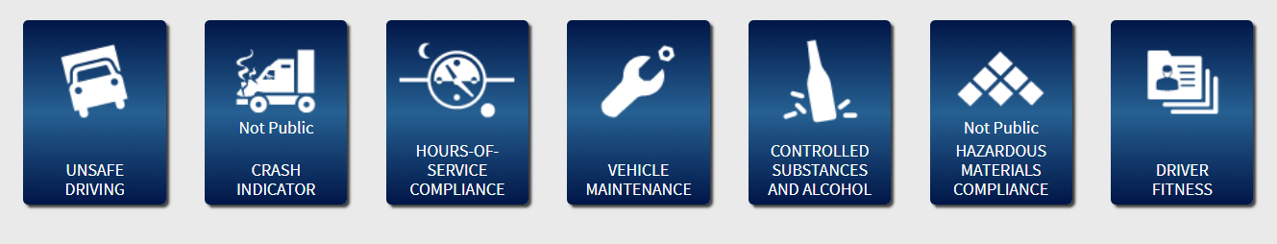
Want to see your Company’s info????
Step 1: Google search “Safer FMCSA”
Step 2: Click on SAFER WEB – Company Snapshot
Step 3: Type DOT # in the Search Field (or by name)
Step 4: On the right side of the screen, click SMS Results
Step 5: Scroll down and click on any of the dark blue boxes to see that category’s violations.

Slide 56
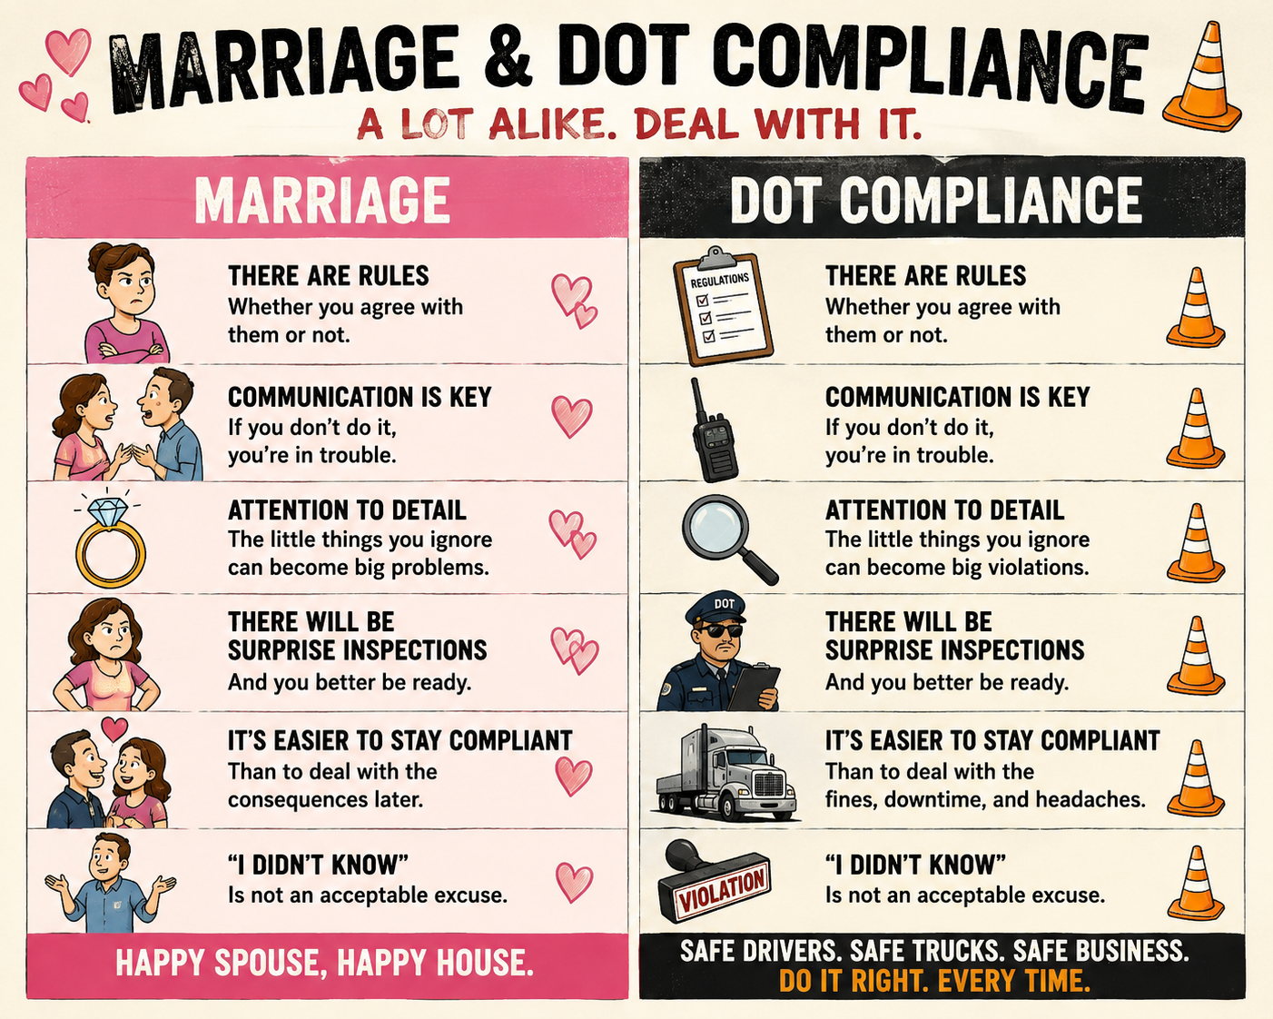

Slide 57

Questions?
Don’t ask me anything hard!

