Slide 1
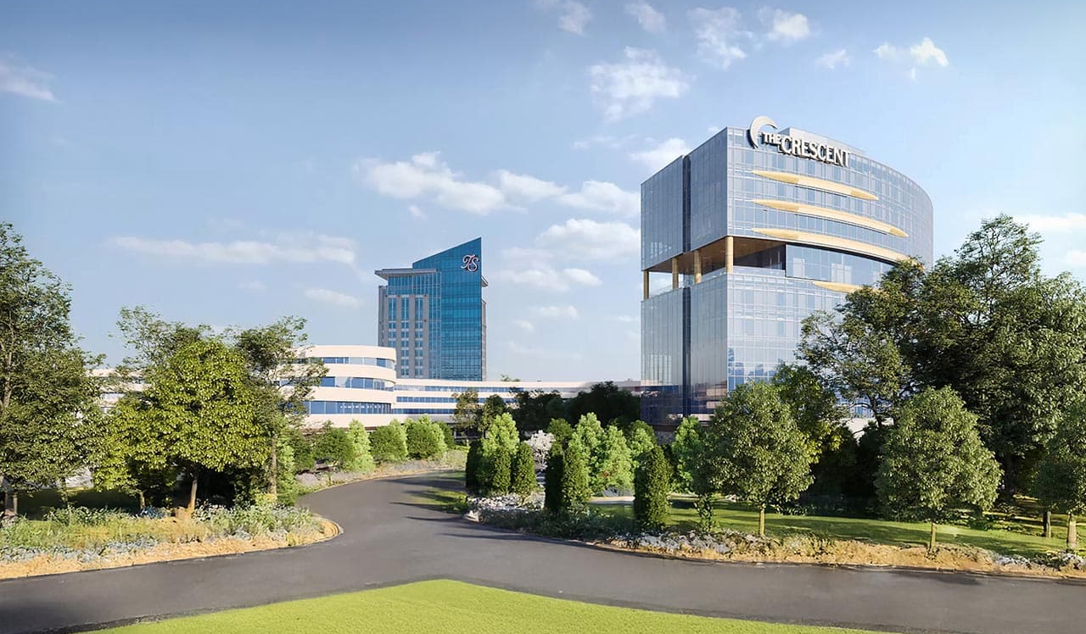



IUOTA 2026 | Verona, NY
Turning Stone Resort & Casino

Slide 2
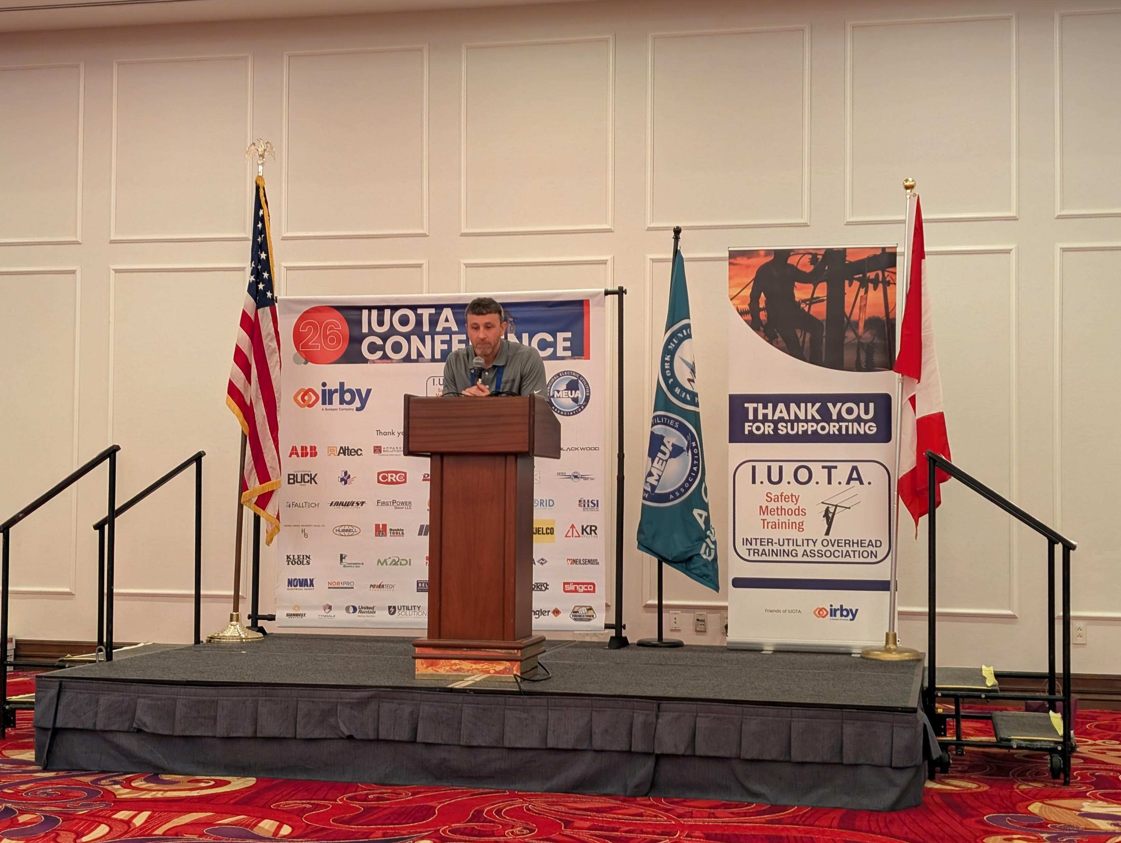
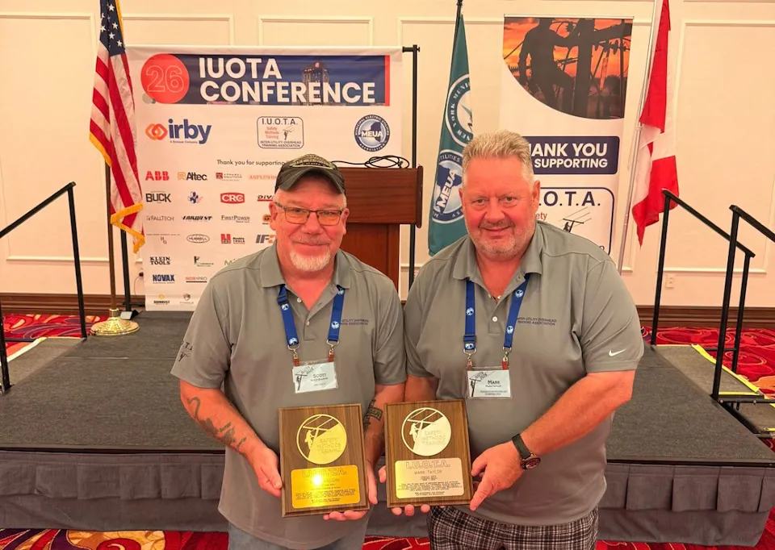
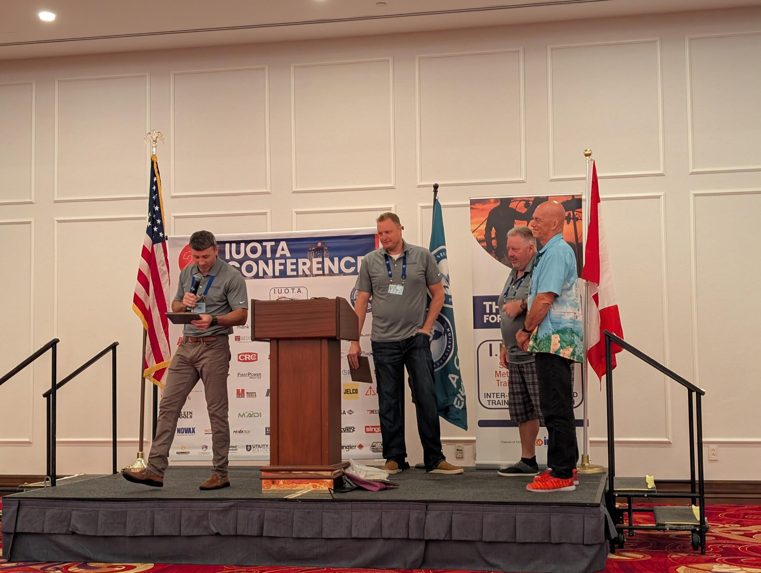
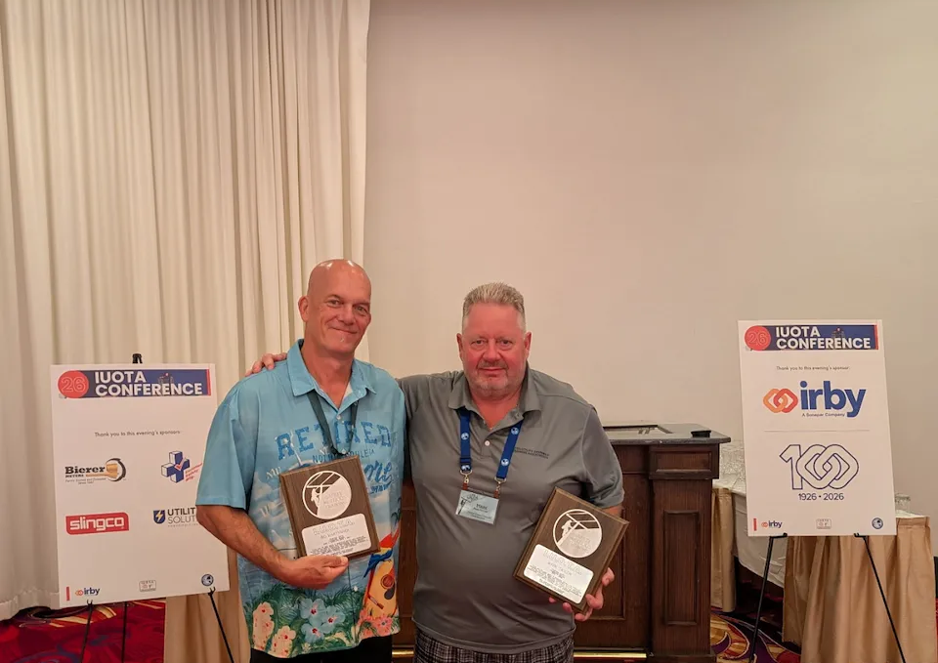
Held August 17–19 at Turning Stone Resort & Casino in Verona, New York, the program centered on safety, training and peer exchange—linking competence, speaking-up culture, leadership and emerging technology.
Rich Paradie, IUOTA Chairperson, kicked off the 2026 conference welcoming guests followed by a recognition award to our past chairpersons Mark Taylor and Robert (Bo) Maryyanek for their dedicated leadership service over past years. Another award was given to Scott Baugh, Vendor Chairperson, for his continued commitment over many years with IUOTA.

Slide 3
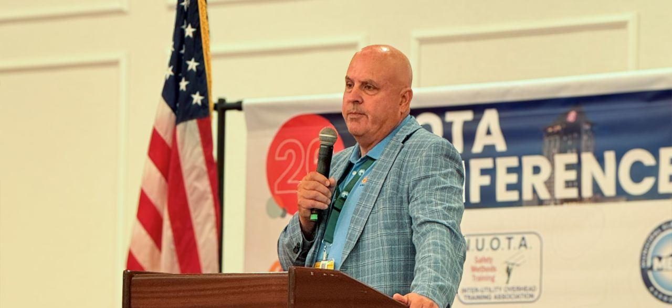
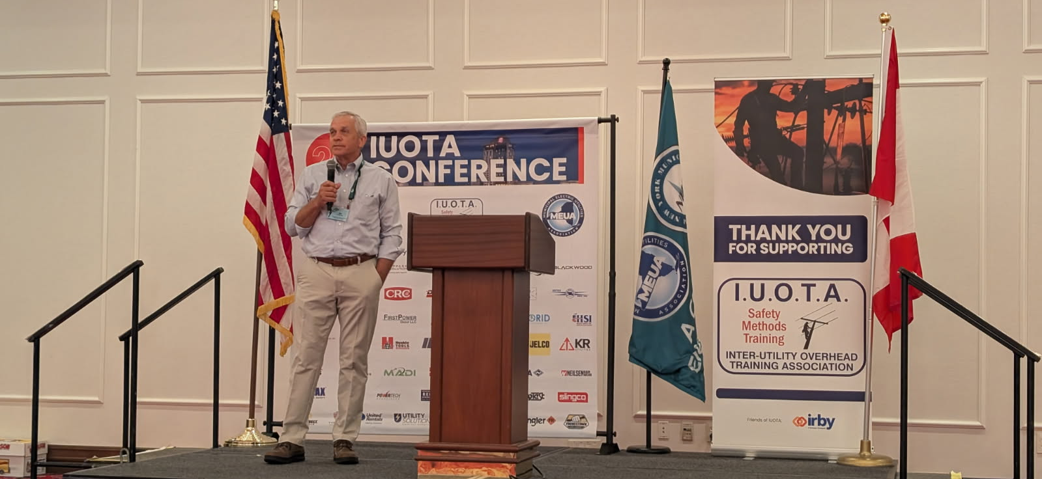
Jim Stokes, MEUA – host utility, and Chad Cravens, Irby – host vendor, delivered a welcome message to all guests of the conference.

Slide 4
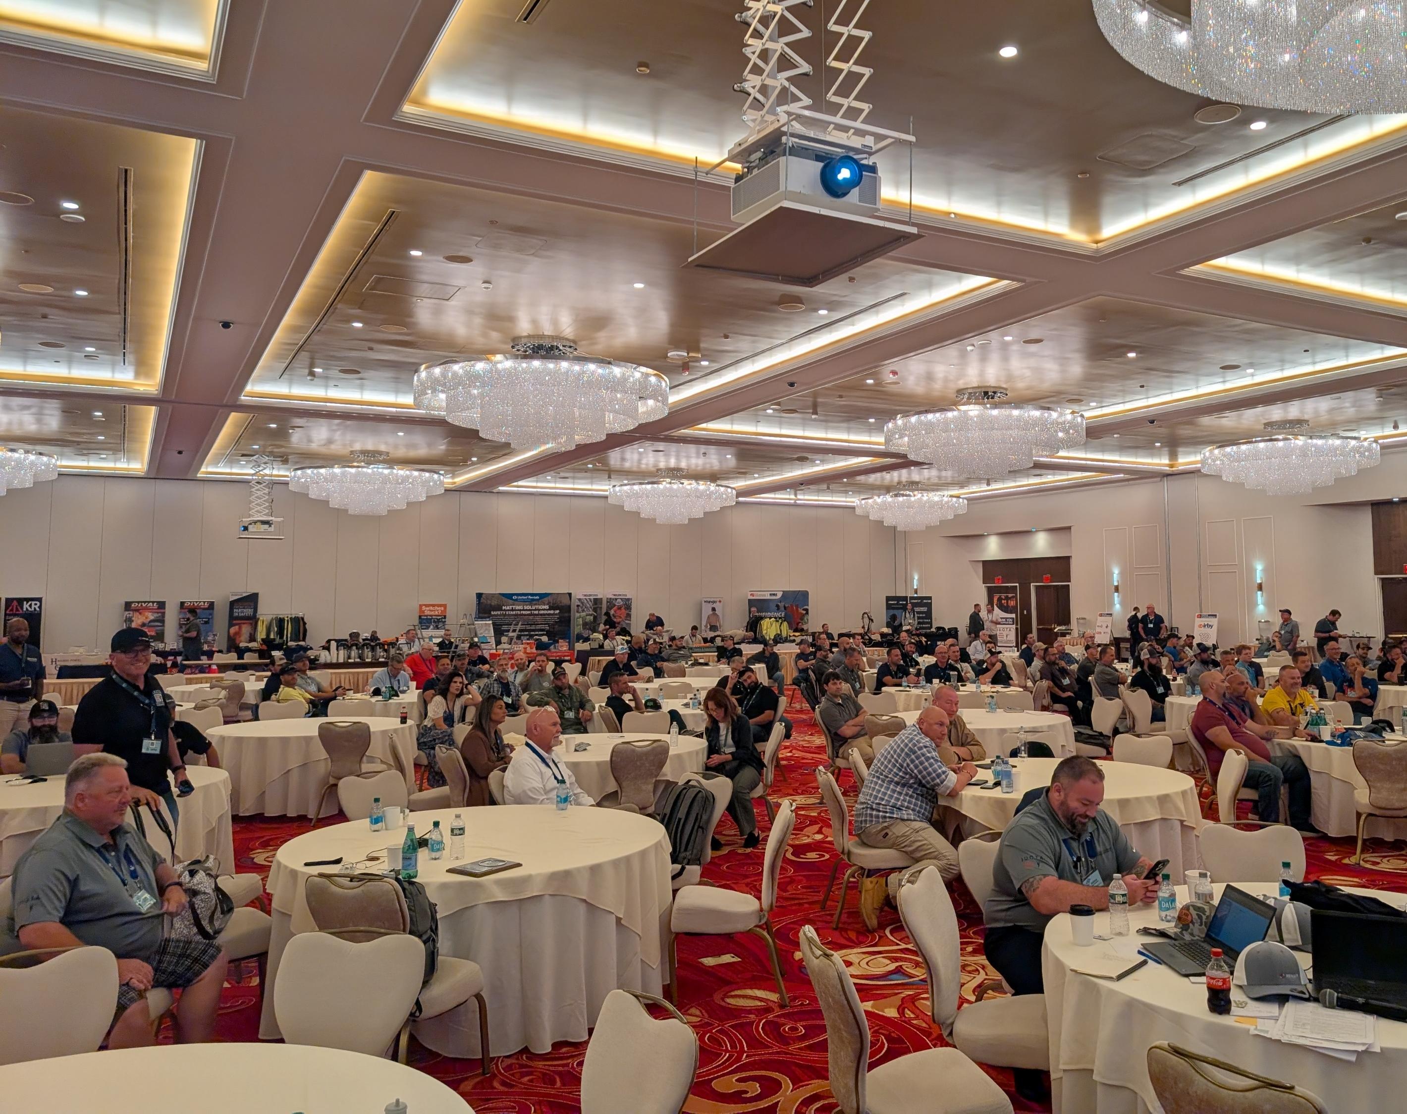
It was an incredible turnout at the 2026 IUOTA Conference! Our biggest attended conferences to date with over 200+ attended guests!
A huge thank you to our host utility - Municipal Electric Utilities Association (MEUA) and host vendor – Irby.

Slide 5
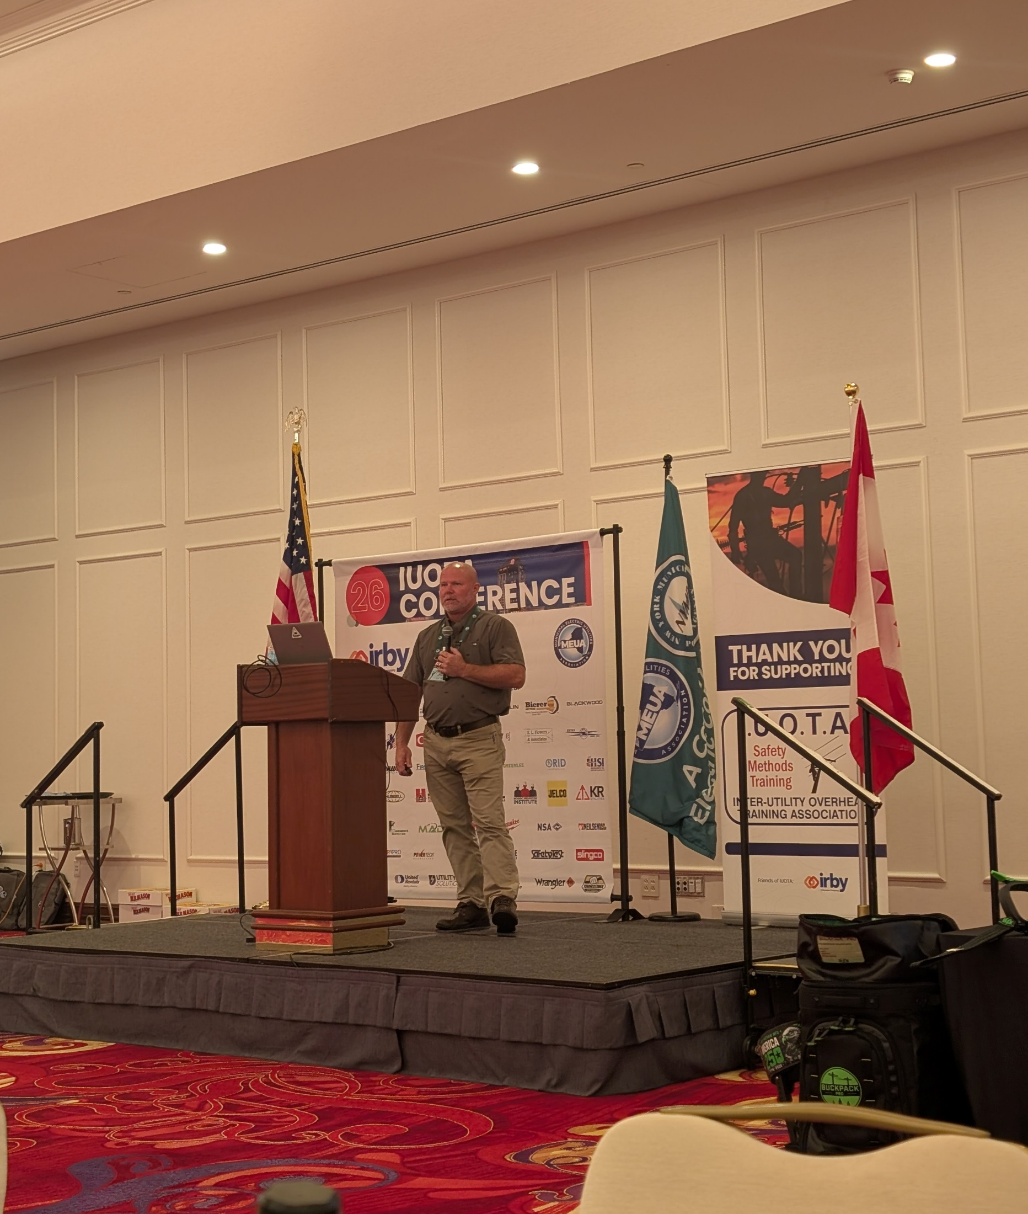
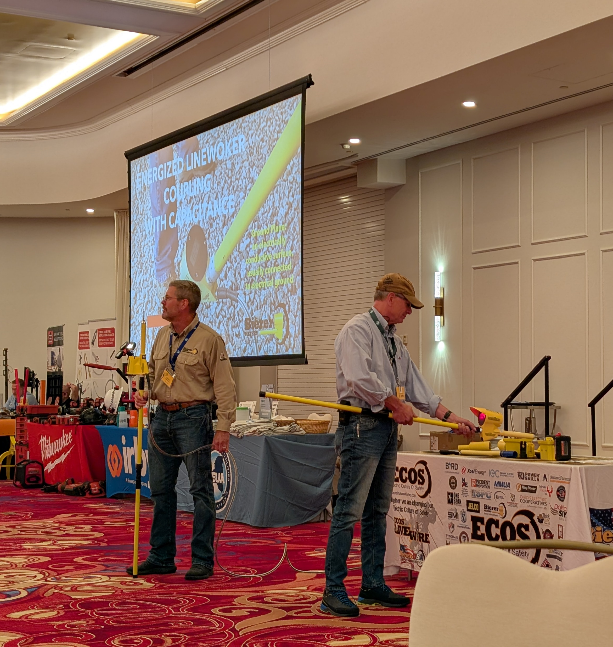
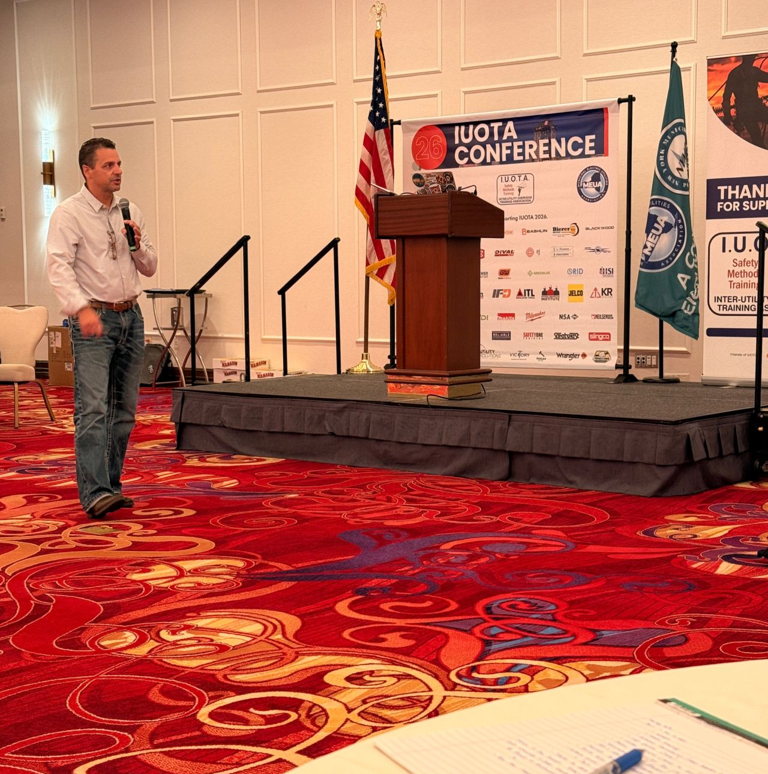
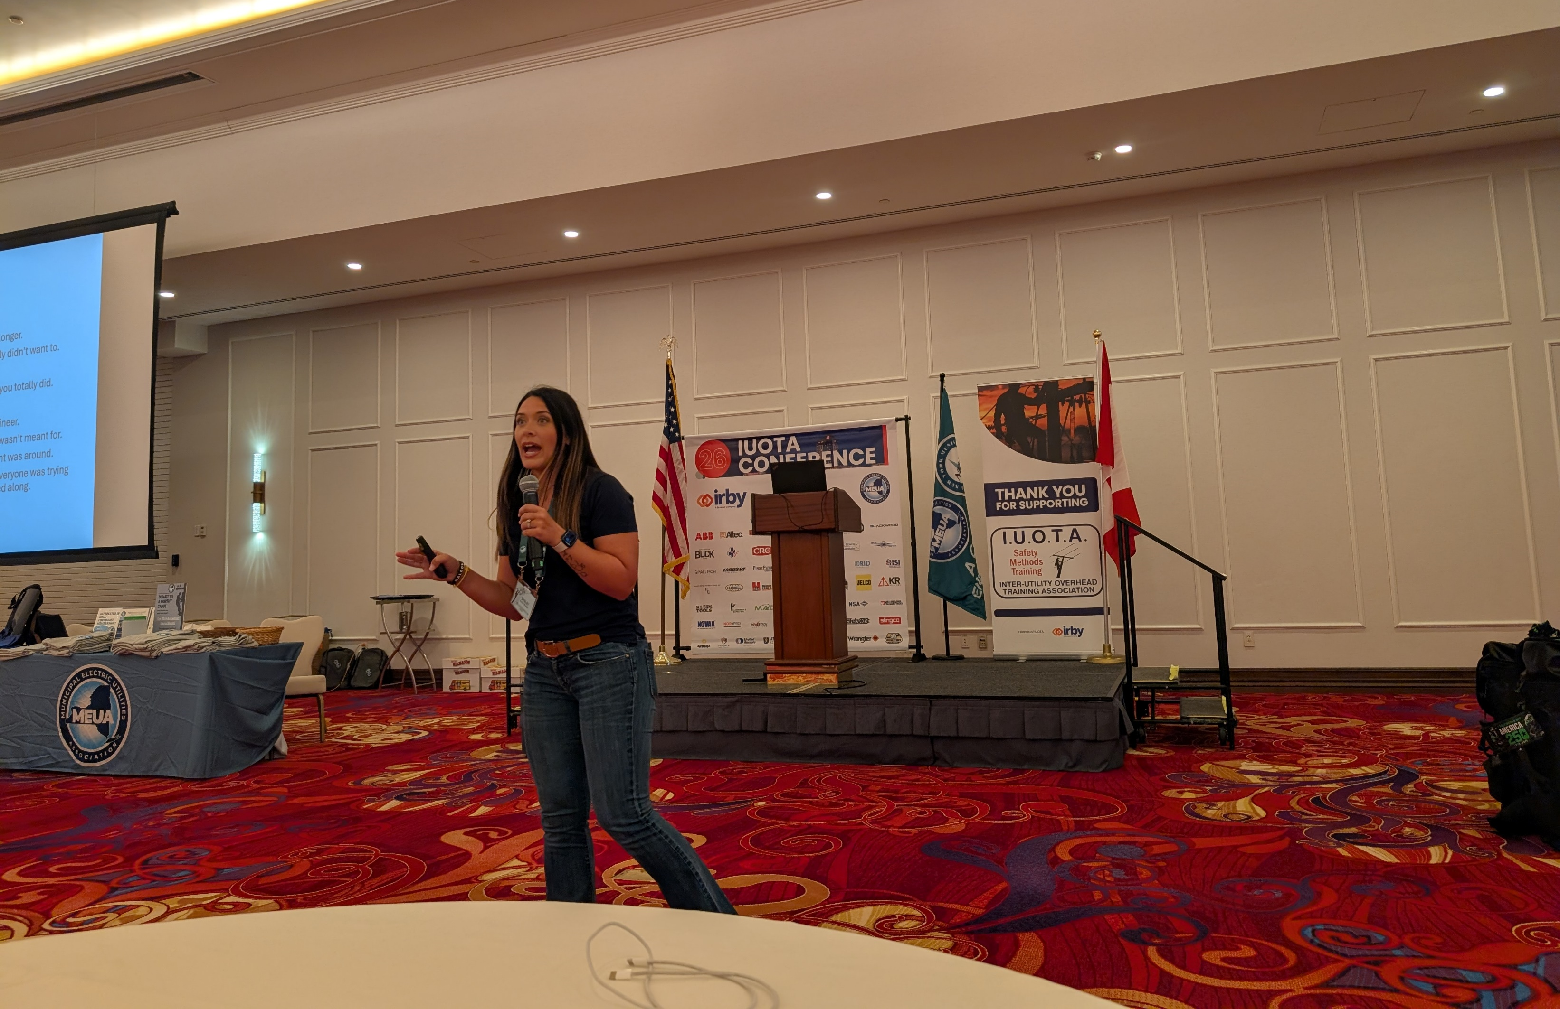
Brett Christy| Protective Cover-up and Safeguard Requirements for Energized Line Work
Brent Jeffries | Safety Tool Competence
Day one was packed with some great presentations and speakers! This also included our industry accident discussion and corrective actions to share amongst our attendees.
Shelby Ramsey | DOT Compliance
Greg Greiner | Adult Education + Training

Slide 6
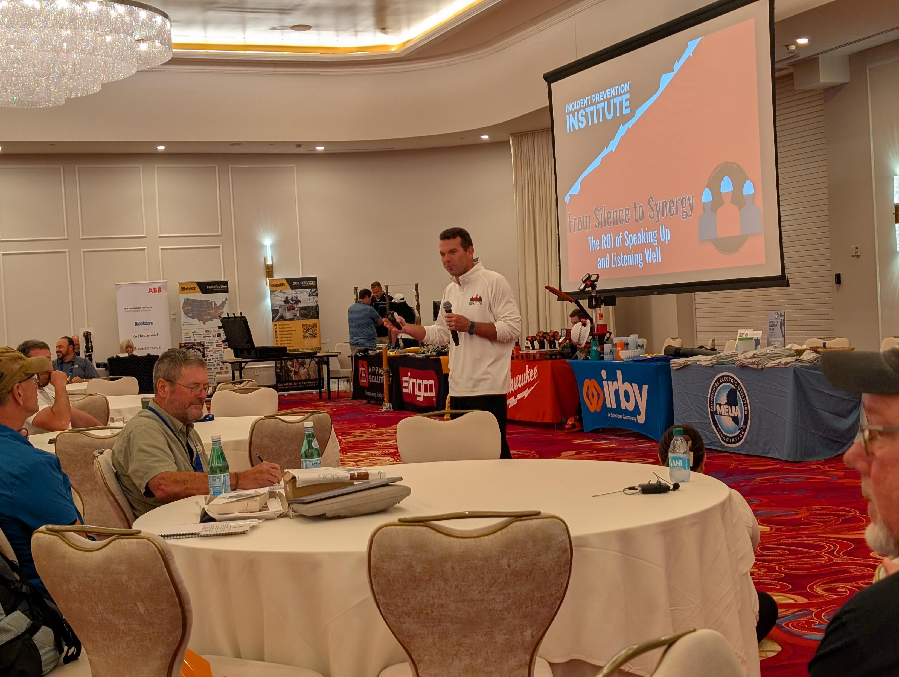
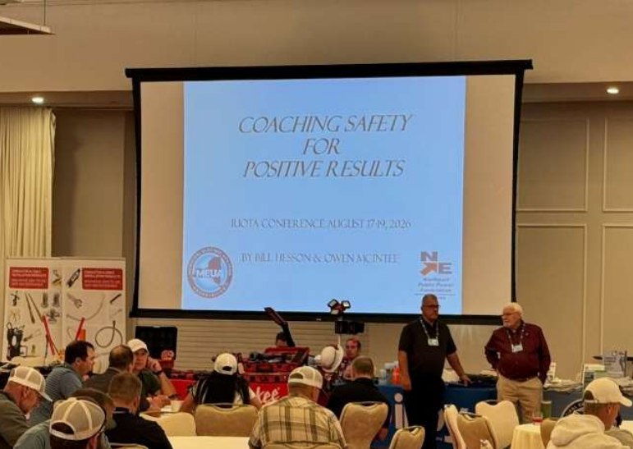
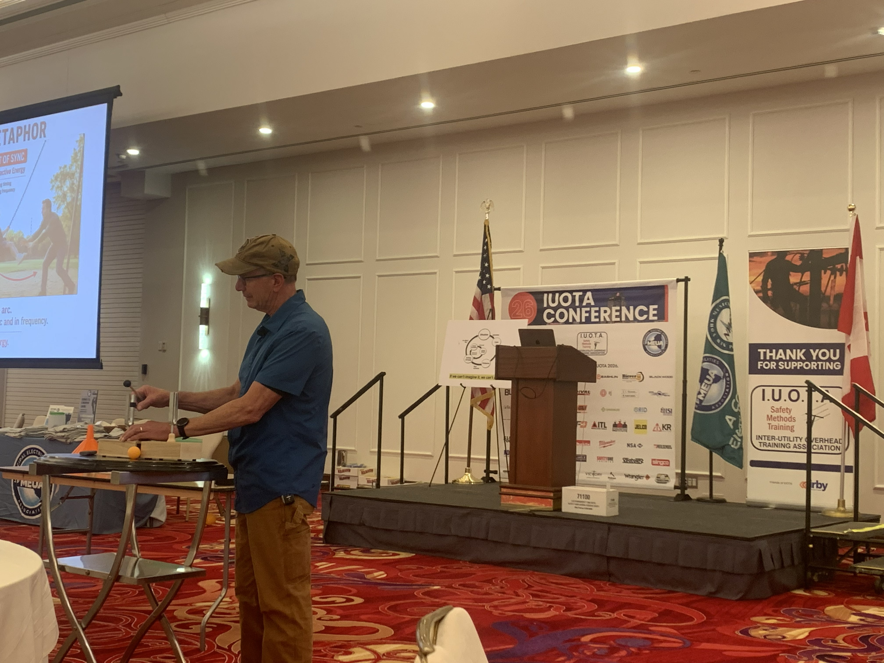
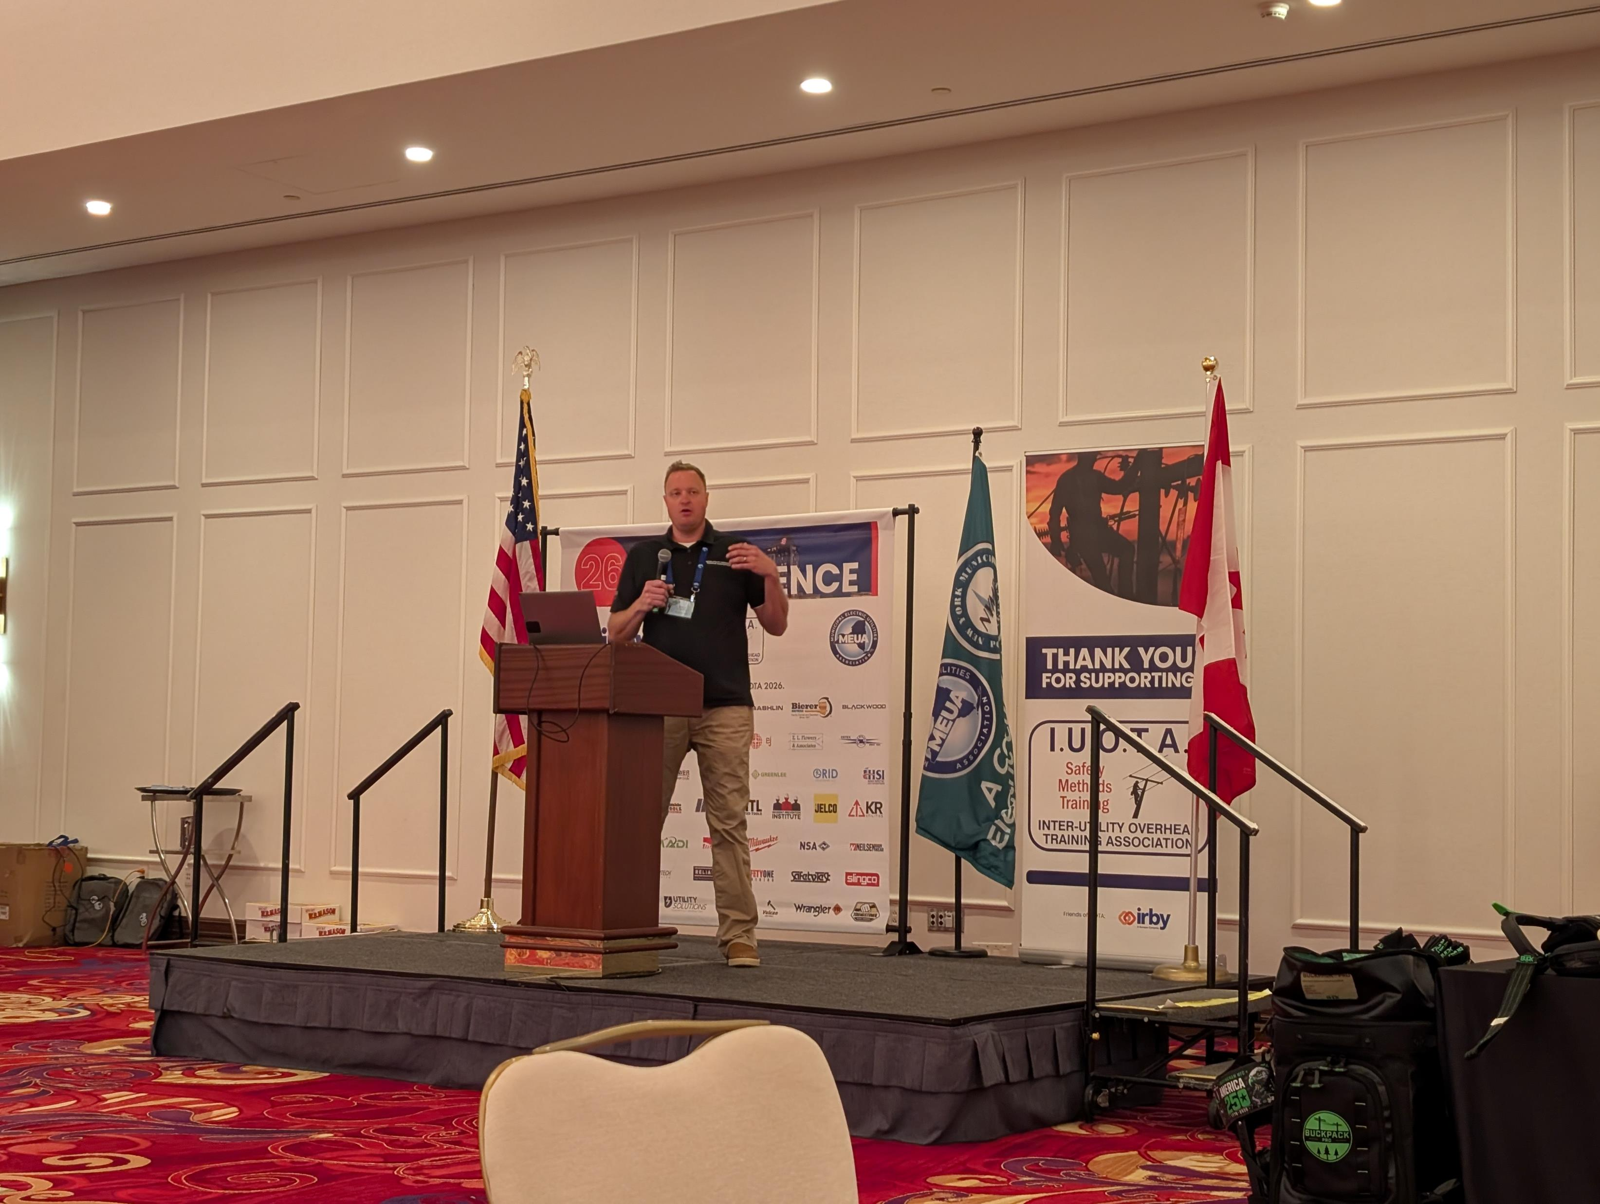
David McPeak, Incident Prevention Institute
From Silence to Synergy
The ROI of Speaking Up and Listening Well
Jim Stokes, Bill Hesson, & Owen McIntee, MEUA
Coaching Safety for Positive Results
Day two included more amazing presentations and speakers which also included round table discussions where we ask our industry peers and vendors any burning questions they may have.
Presentation- Billy Martin, Think Tank Project, LLC
Are Root Causes the Product of Root Conditions
Steve Kopp, MJ Electric
How AI is Redefining Workplace Safety

Slide 7
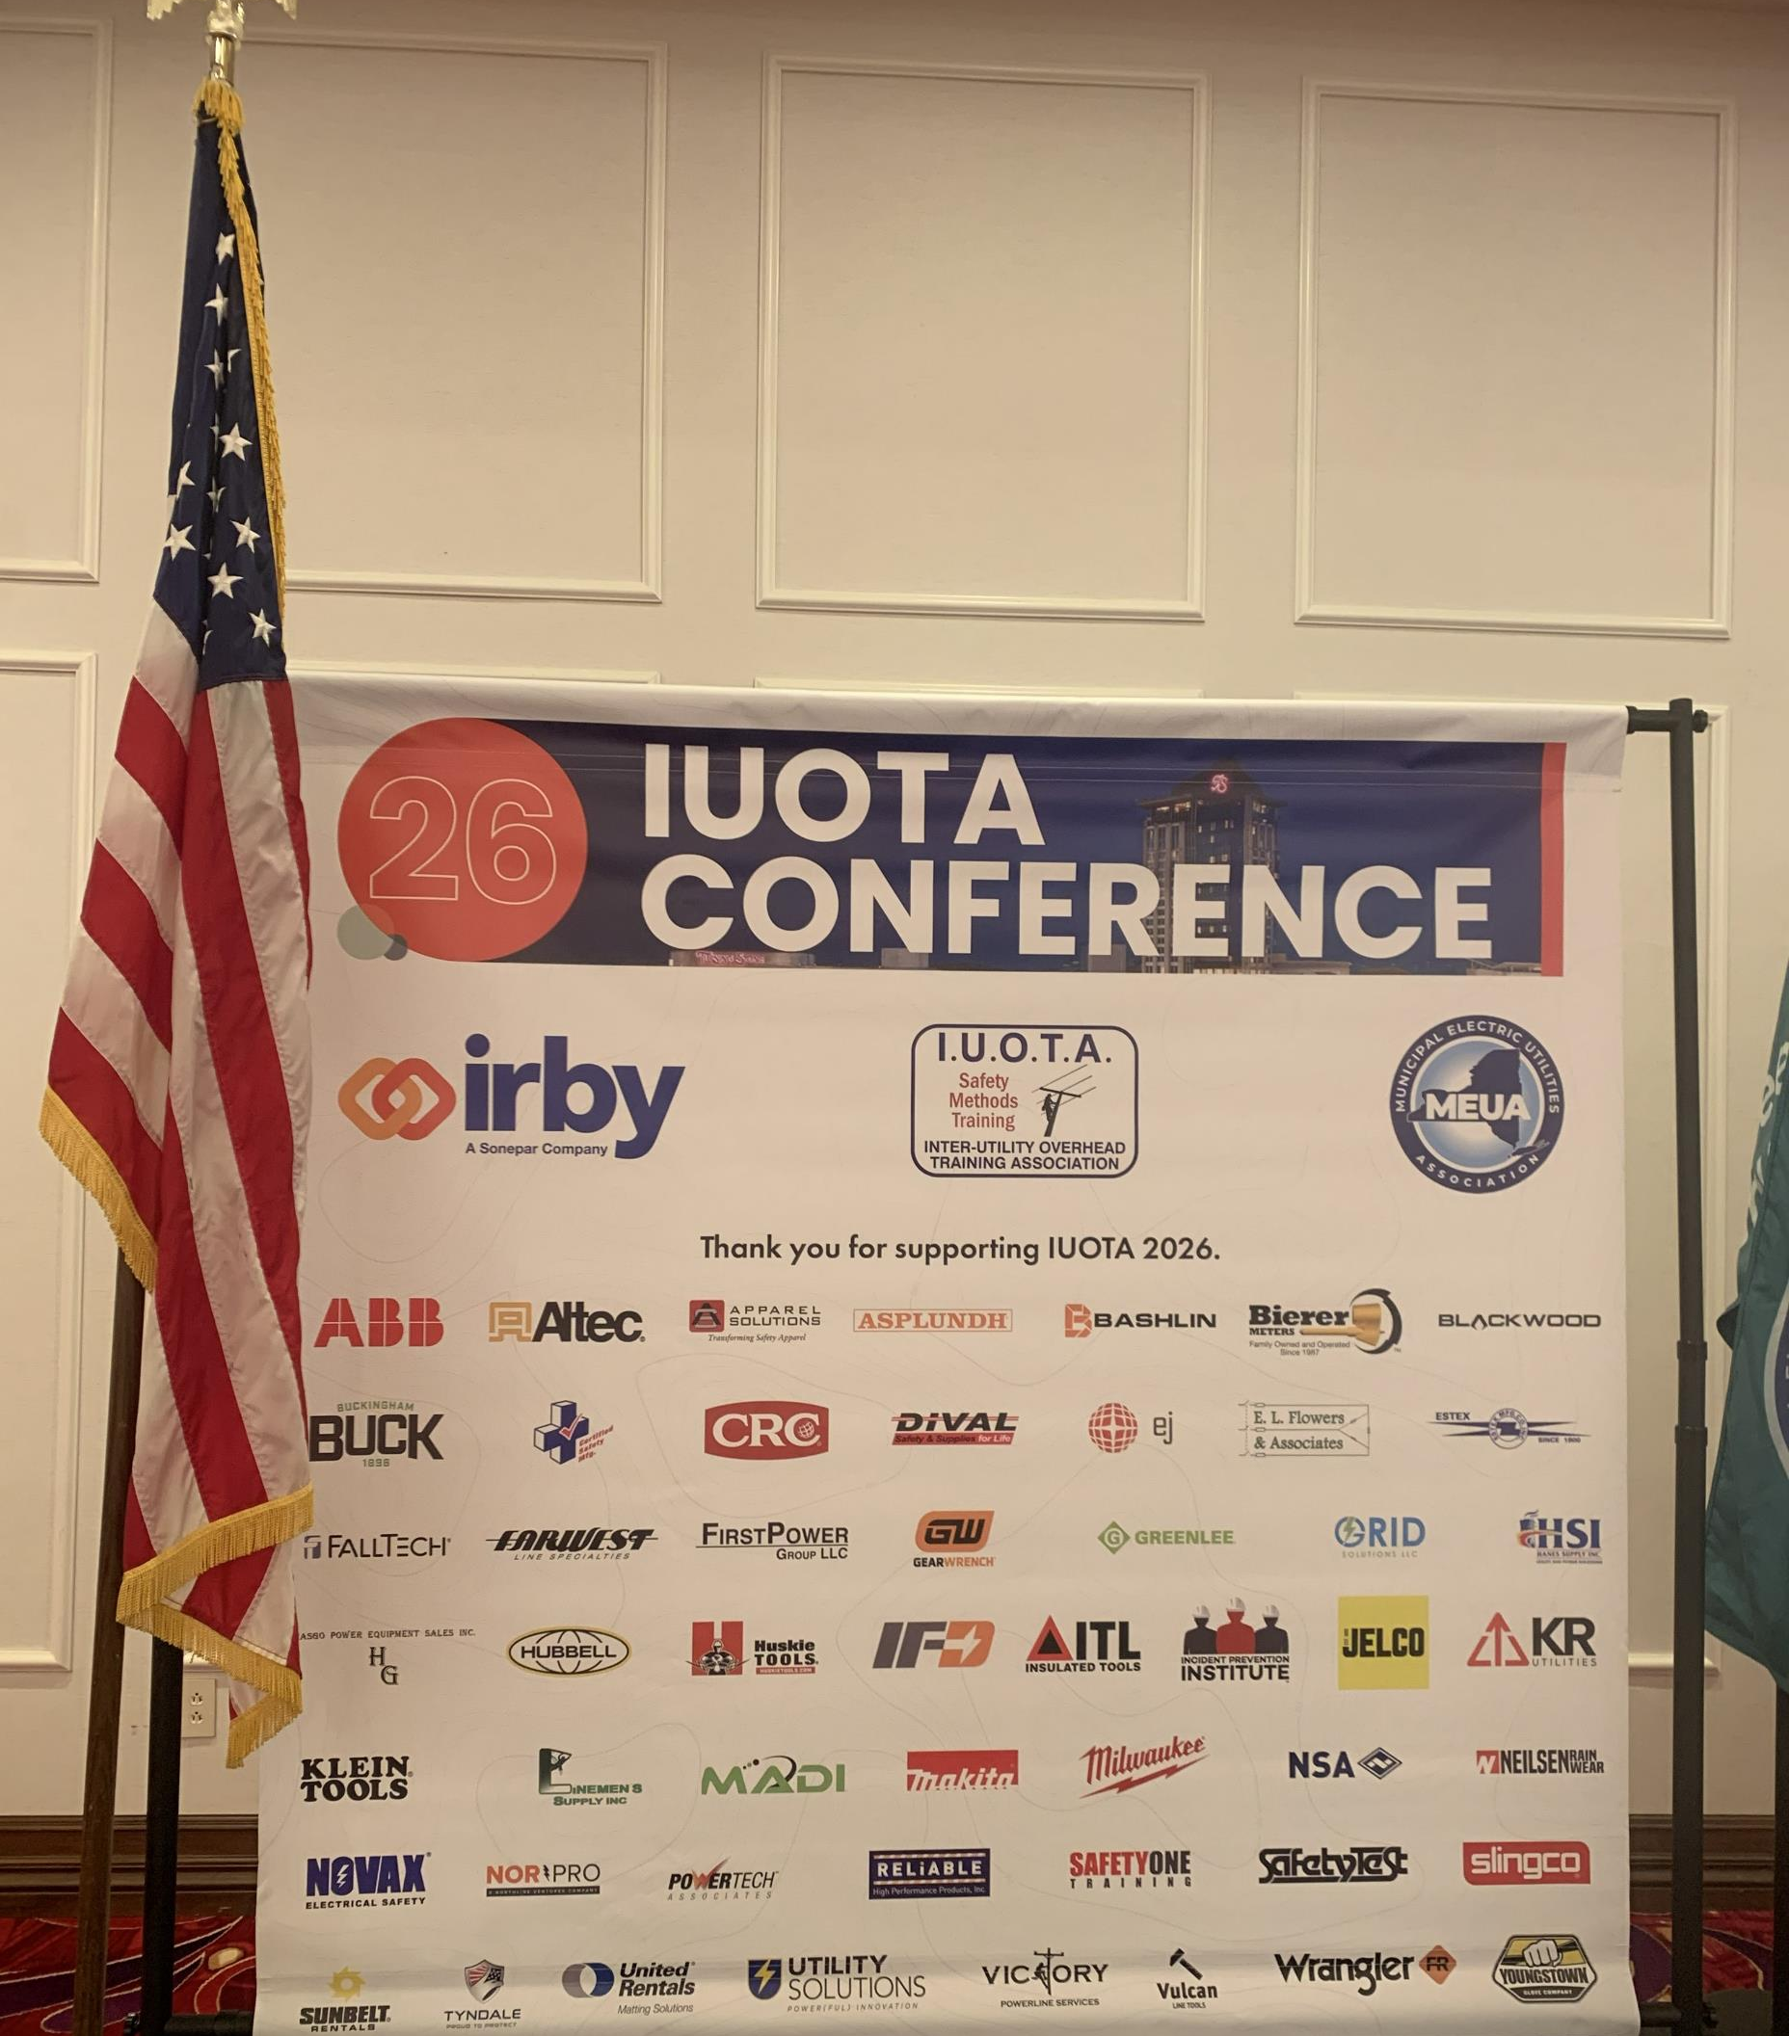
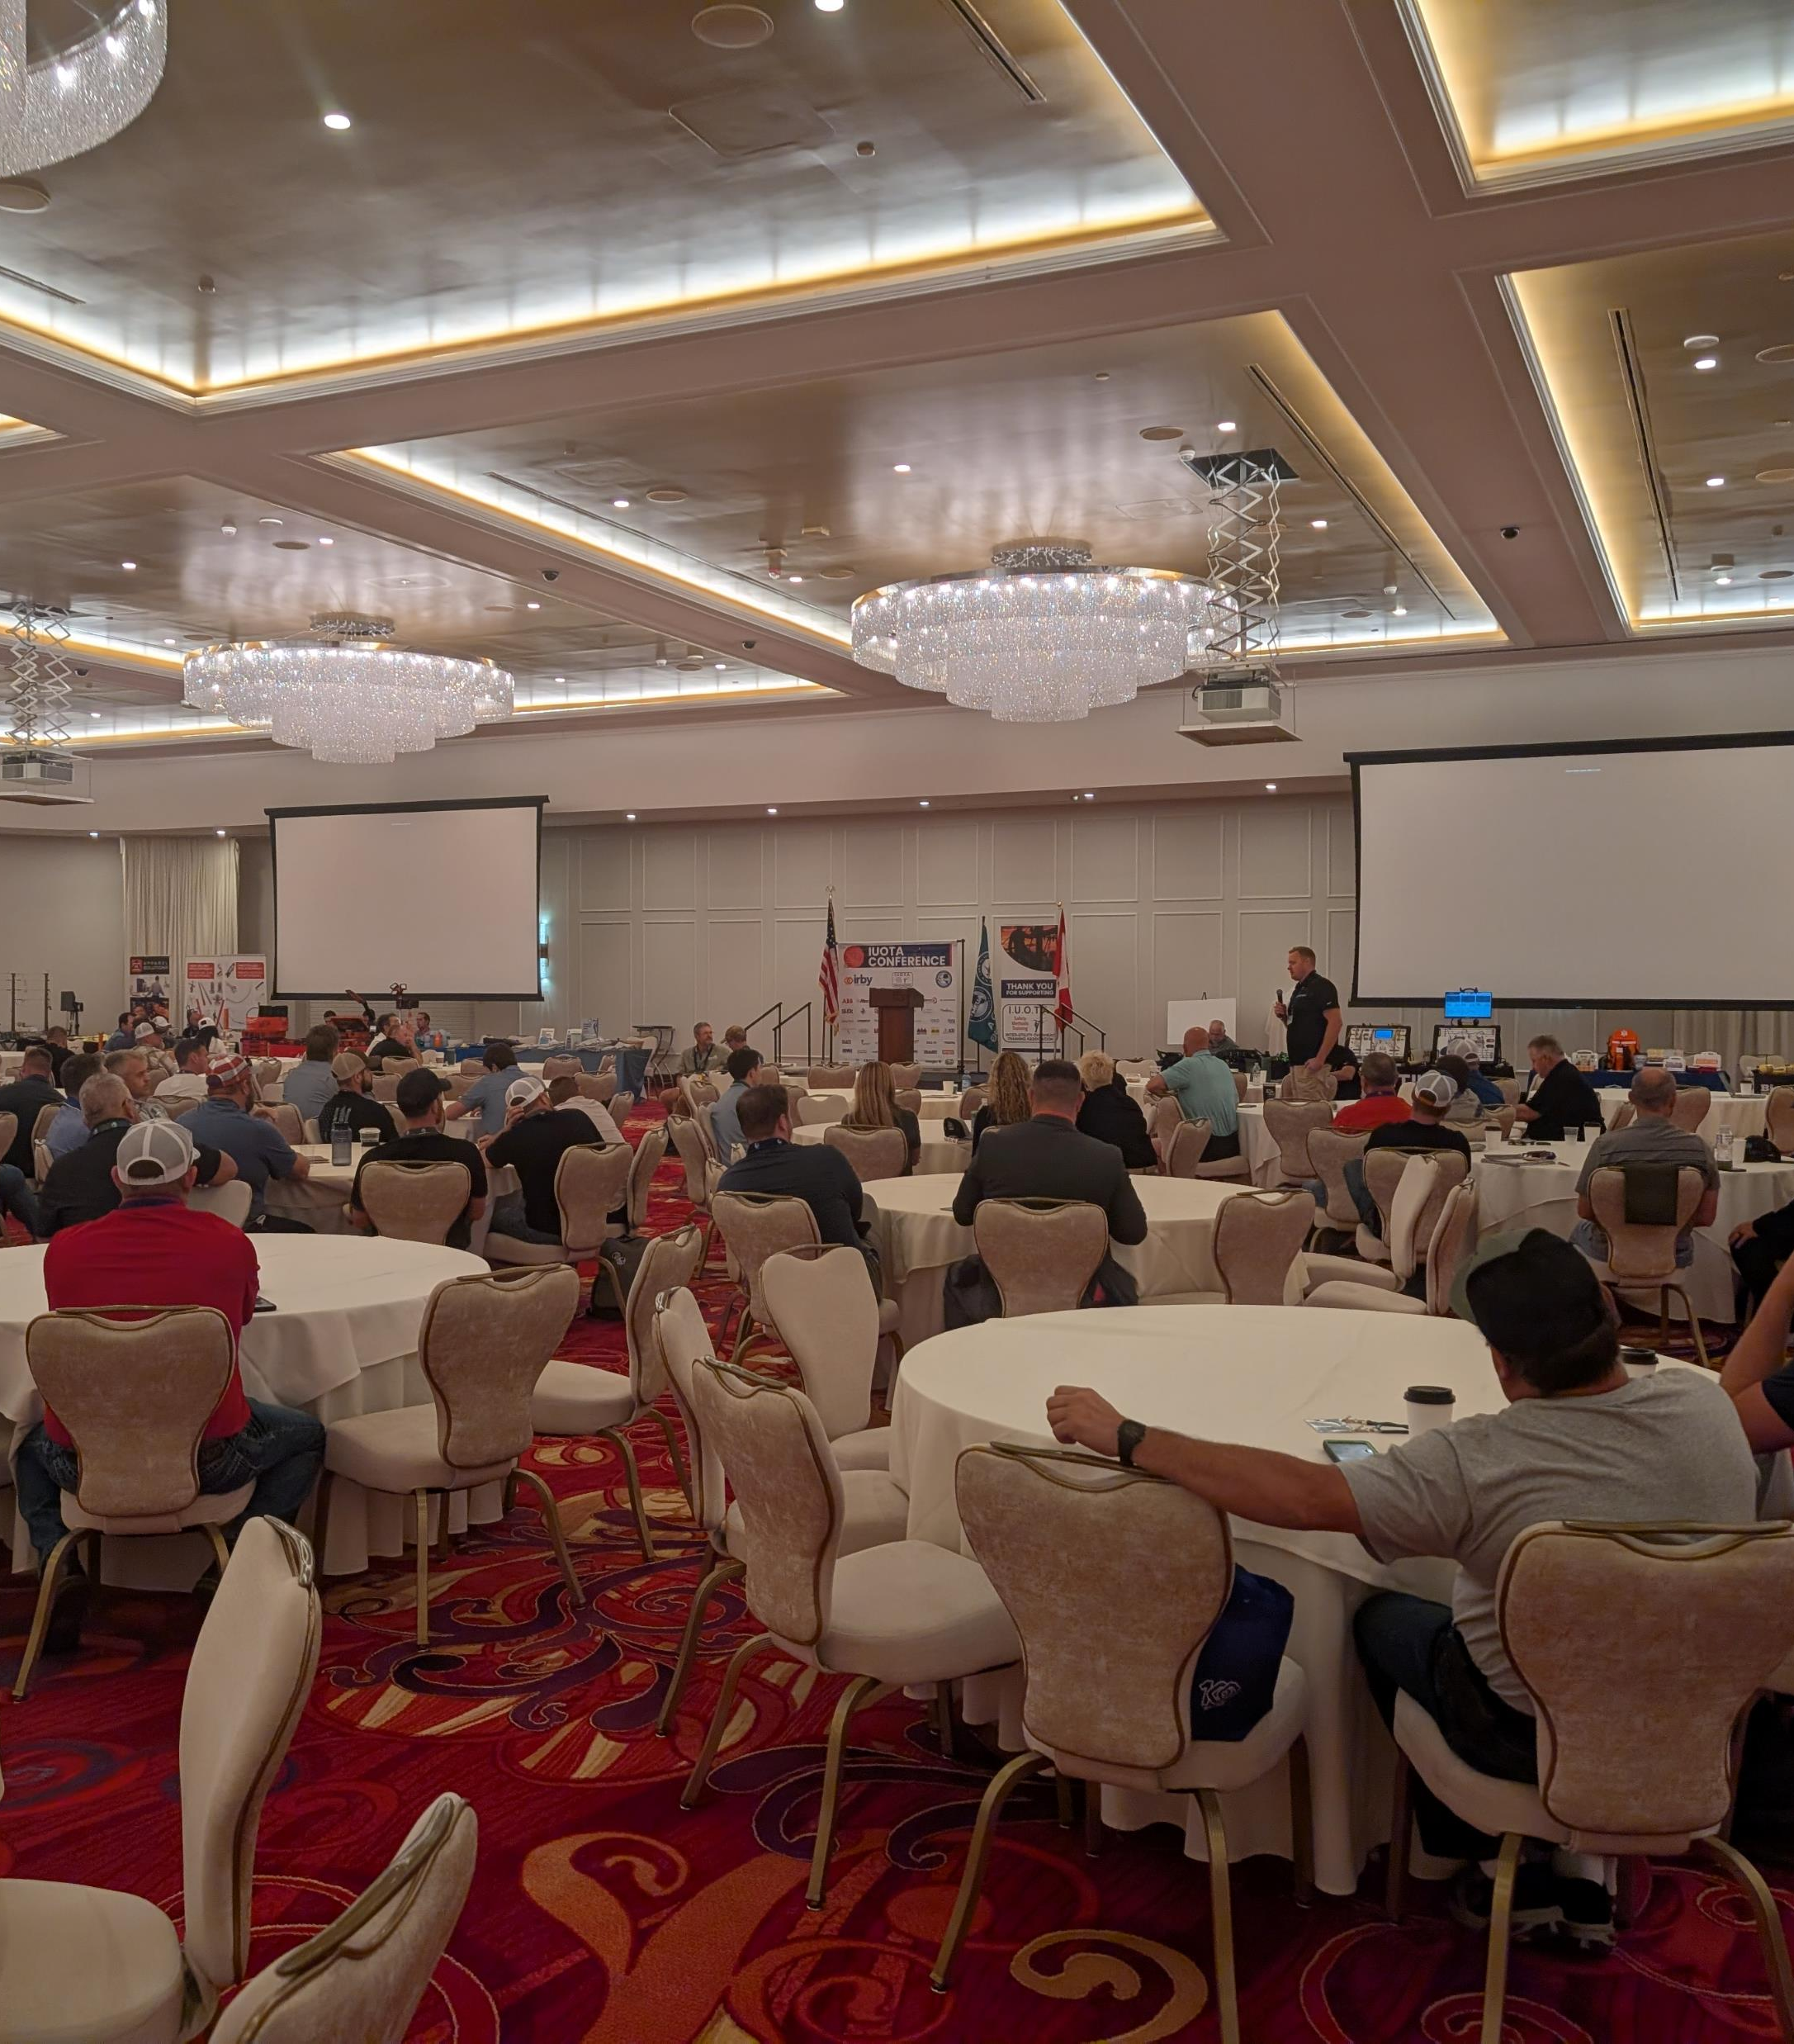
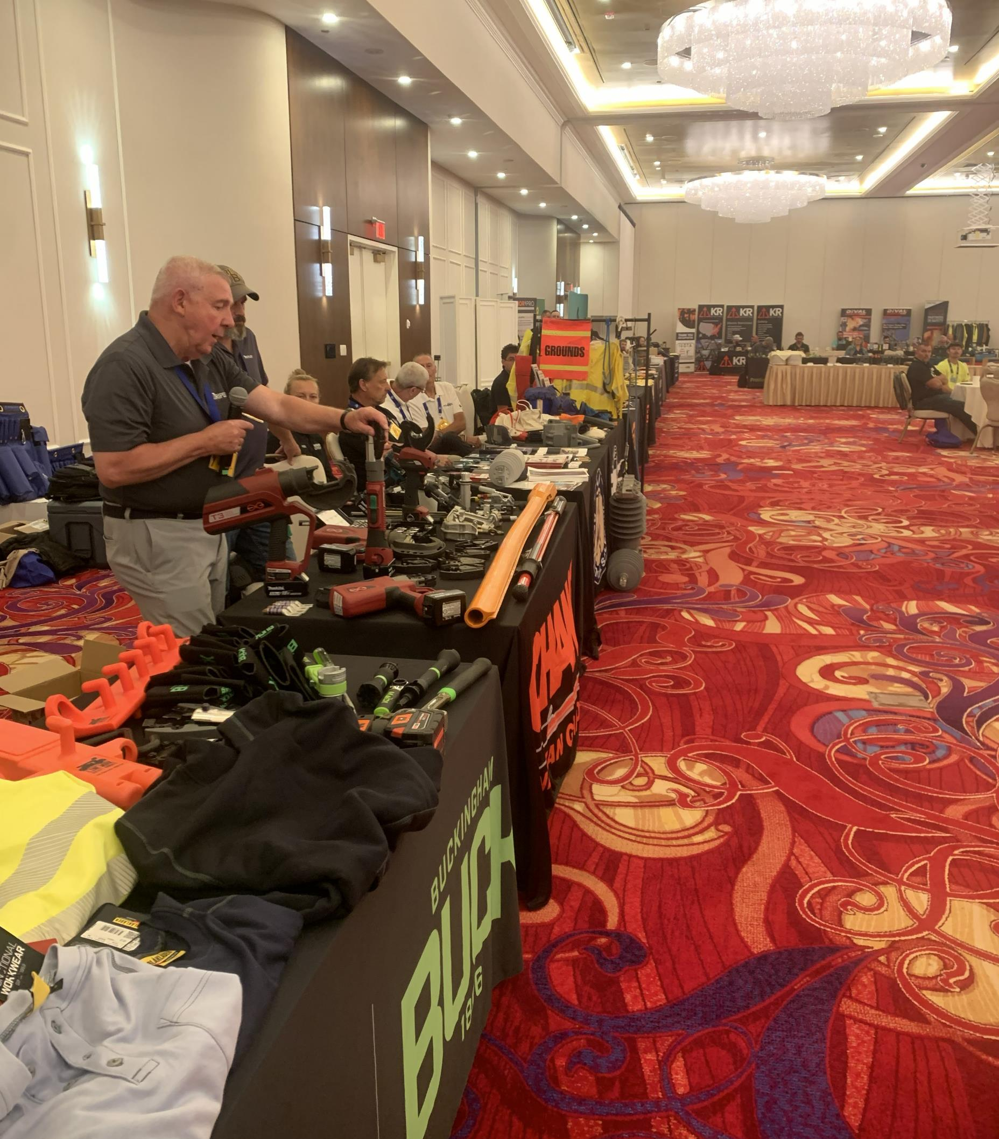
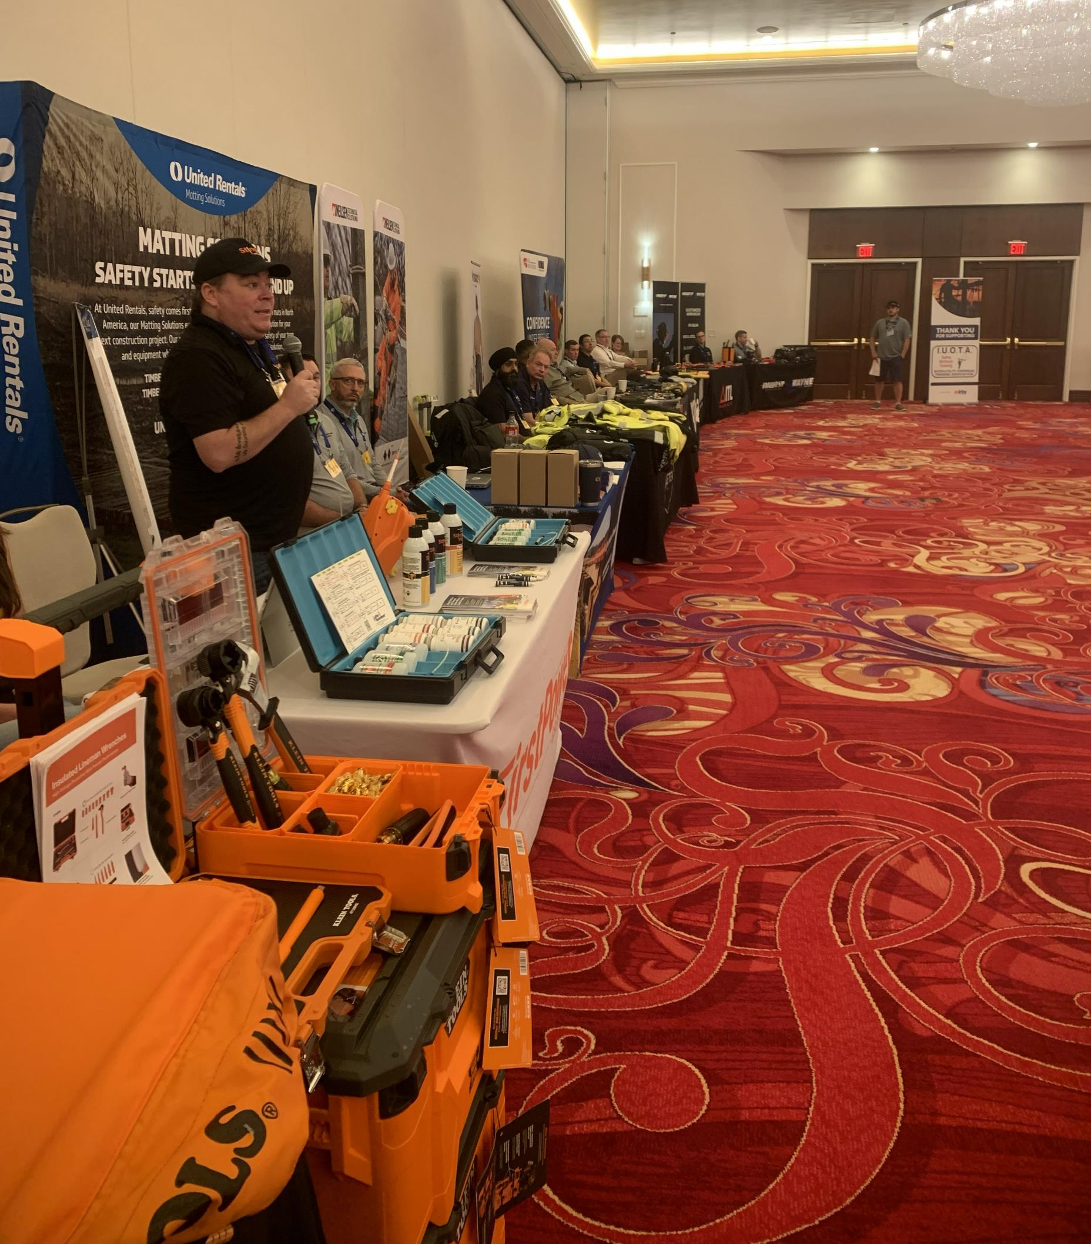
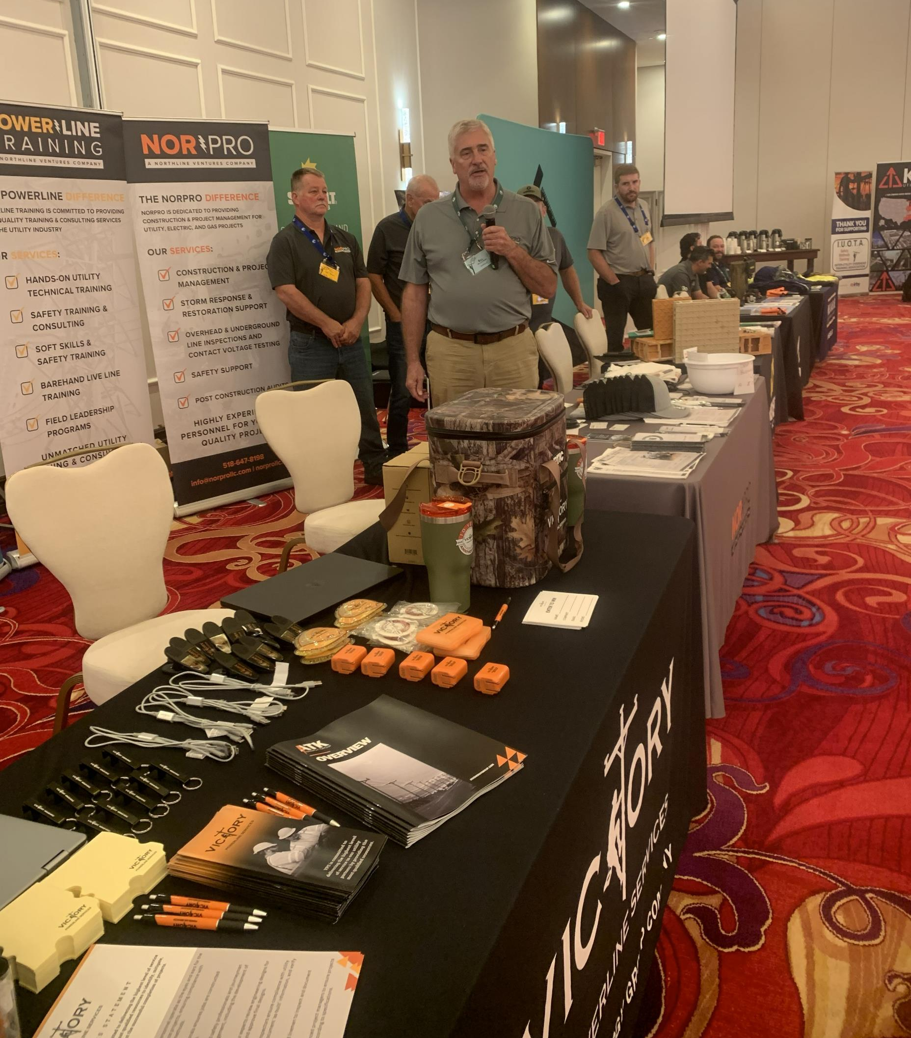
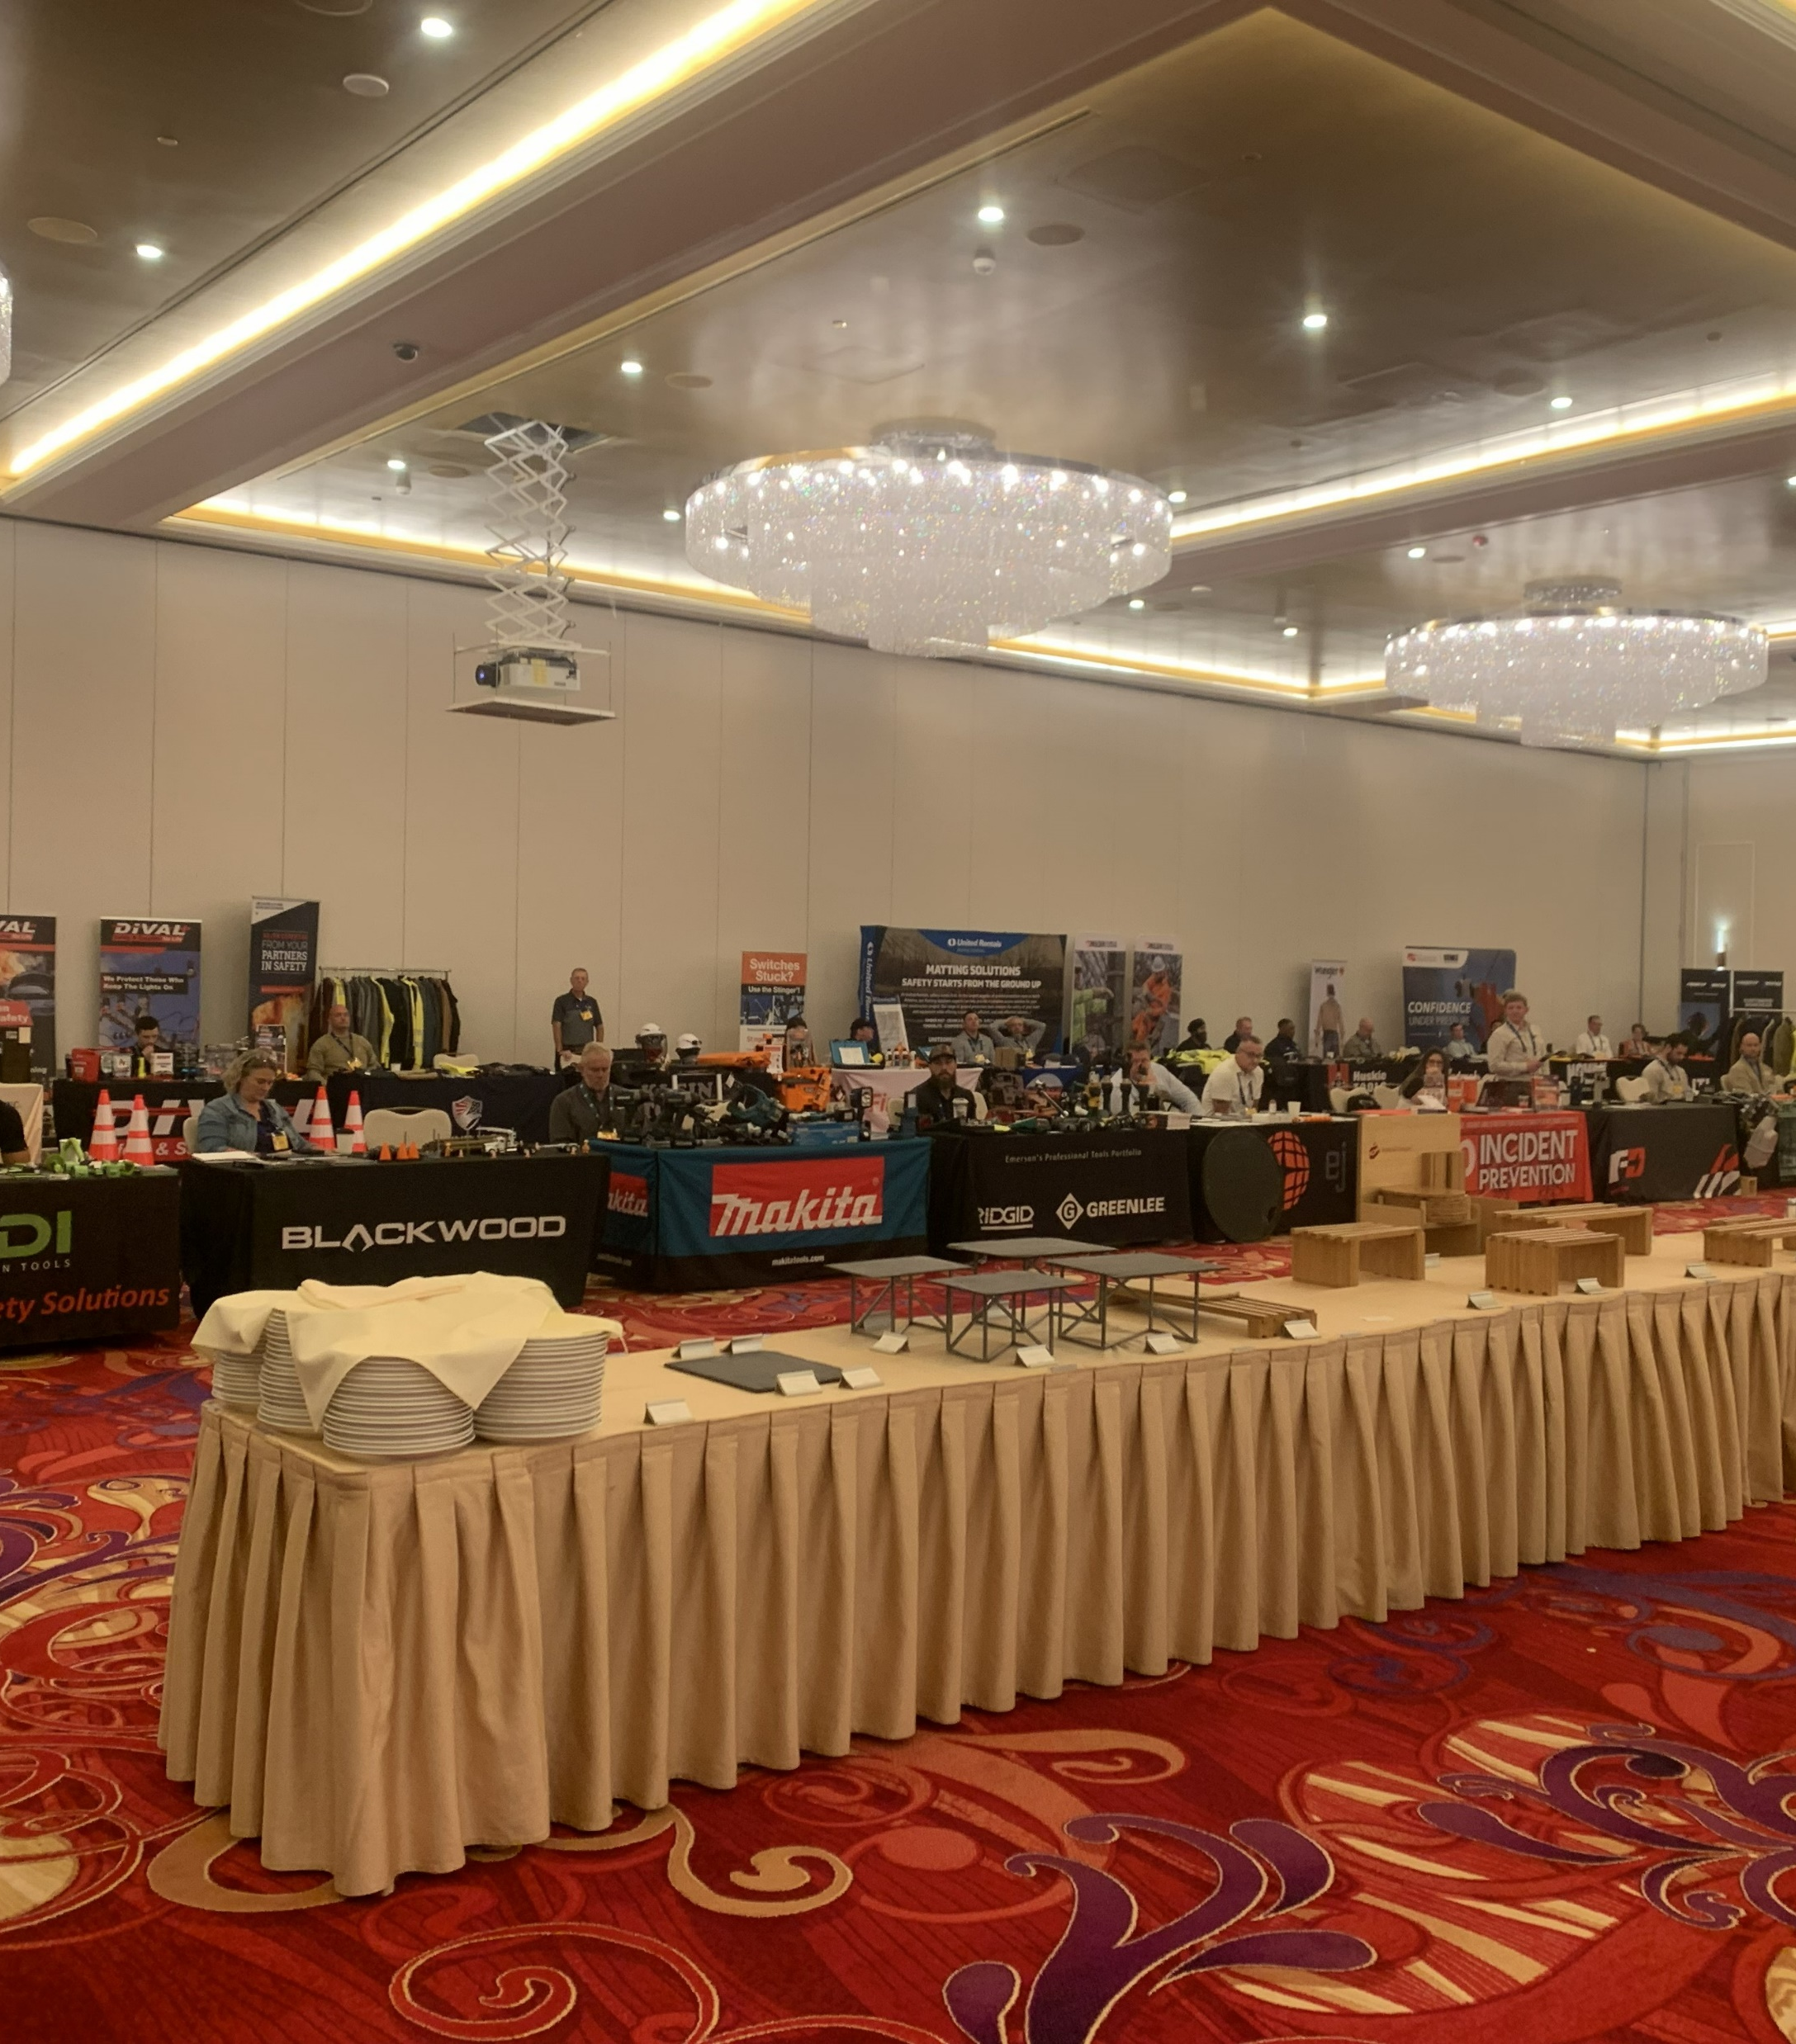
This conference could not have been a success without the continued support of our incredible vendors! Thank you to all our vendors for all the support!

Slide 8
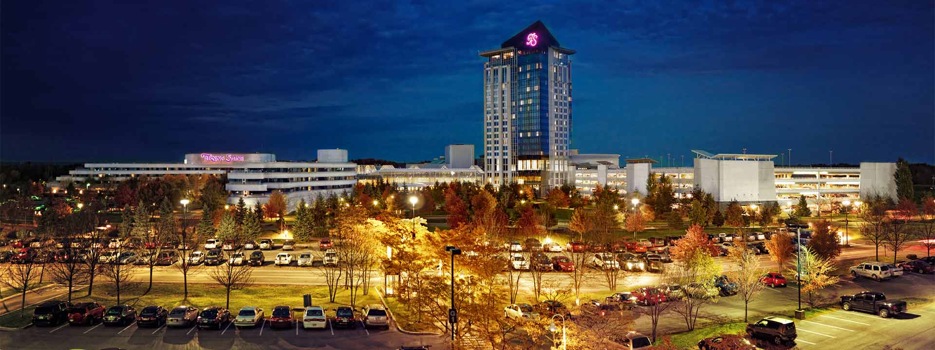
IUOTA 2026 reinforced a practical throughline: speak up, learn from incidents, strengthen competence and bring safer work methods home. Thank you to MEUA, Irby, the presenters, sponsors, vendors and attendees who made the conference possible.
Special shoutout to the Turning Stone Resort and Casino staff!

Slide 9
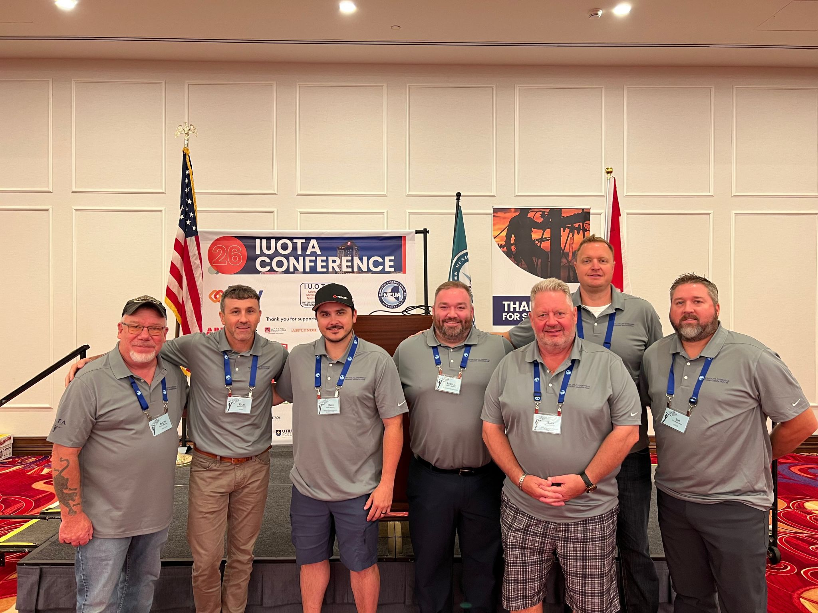
HOSTS
Host utility — MEUA
Host vendor — Irby
IUOTA OFFICERS
Chairperson — Rich Paradie
Vice Chairperson — Steve Kopp
Past Chairperson — Mark Taylor
Secretary — Mark Geddes
Co-Secretary — Tim Boschman
Vendors Chair — Scott Baughn
Social / Website & Vendor Support — Josh Baughn

