Slide 1
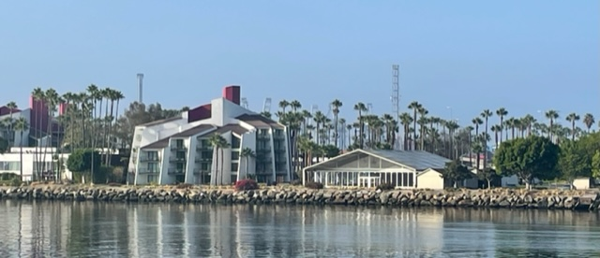
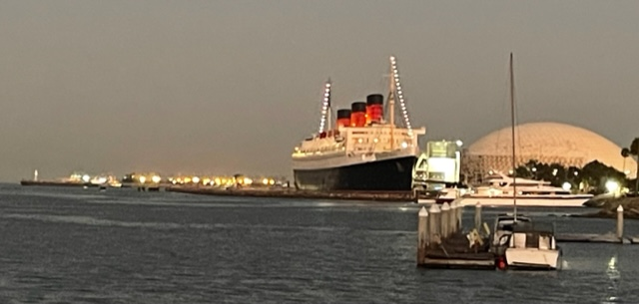
The 2022 IUOTA Conference was a huge success at Hotel Maya in Long Beach, California
August 16th through the 18th

Slide 2
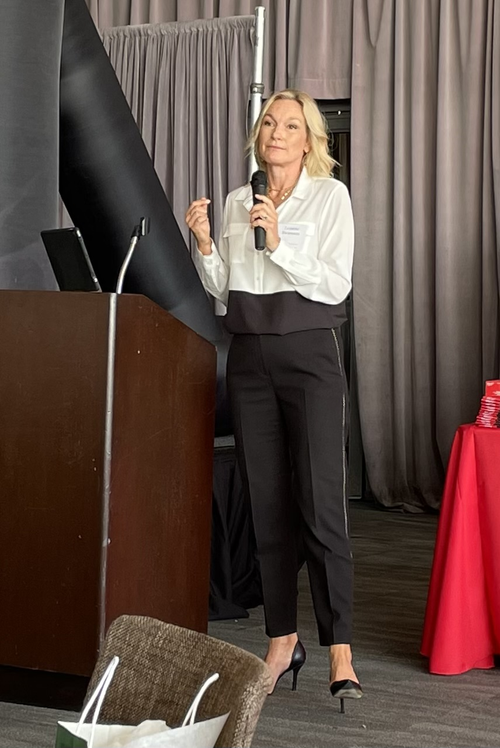
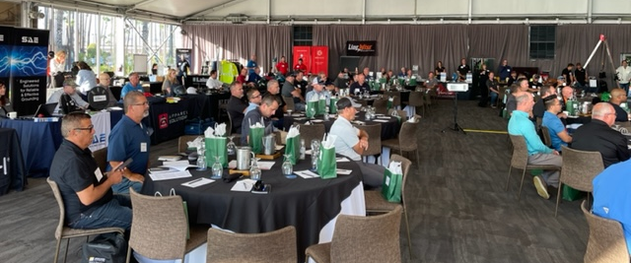
The conference was hosted by Southern California Edison with a warm welcome from Leanne Swanson, Director of Employee and Contractor Safety

Slide 3
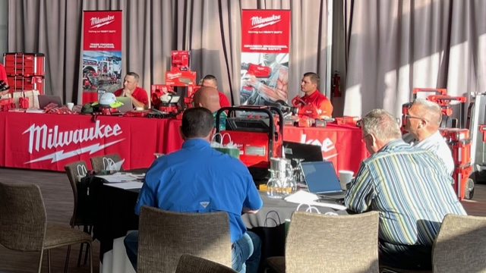
The Milwaukee Tool staff were spot-on as the hosting vender.

Slide 4
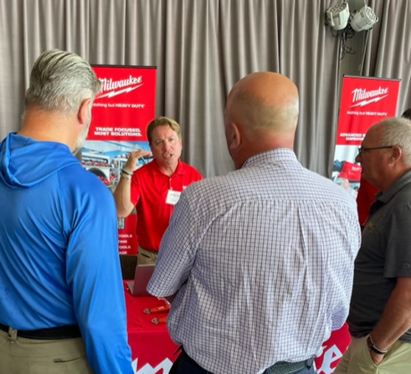
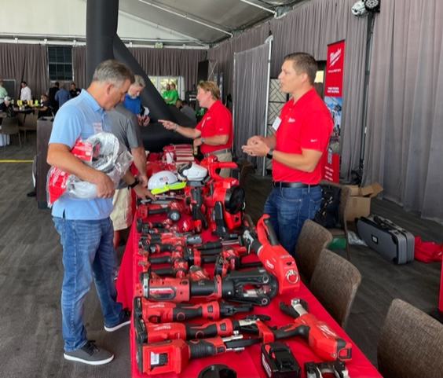
Discussions lead to questions that usually provide the answer someone else is needing.

Slide 5
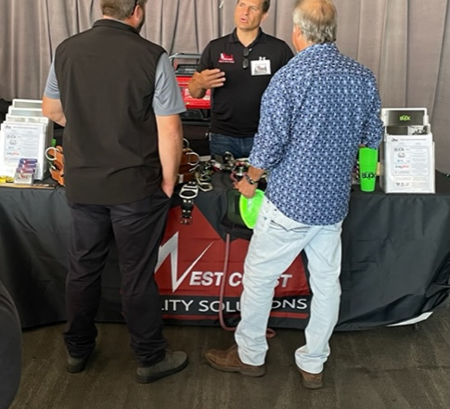
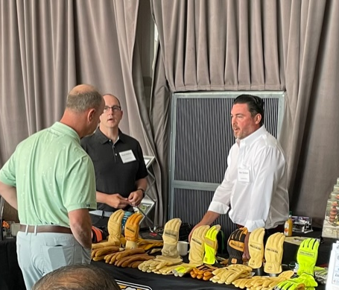
The conference not only allowed companies to share their newest tools but answer many questions and concerns about related tool issues in the field.

Slide 6
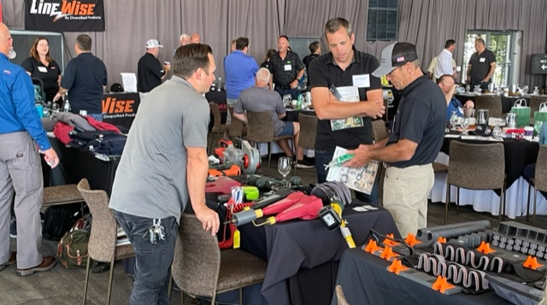
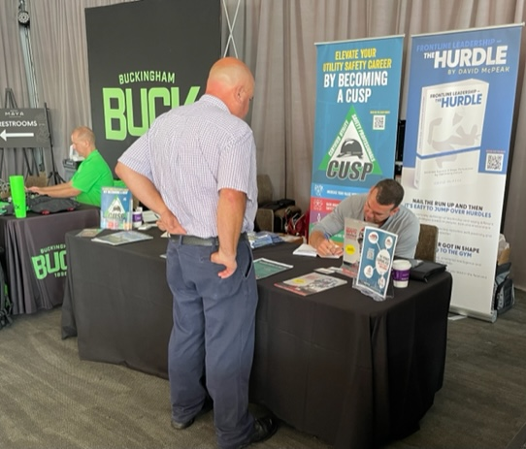
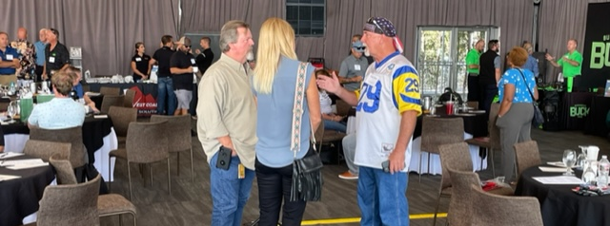
David McPeak was on site delivering helpful safety and training information as always.
Be sure you get a copy of David’s new book
“The Hurdle”

Slide 7
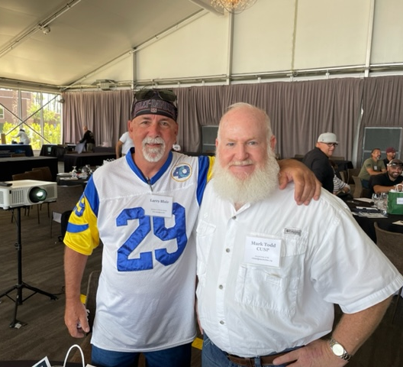
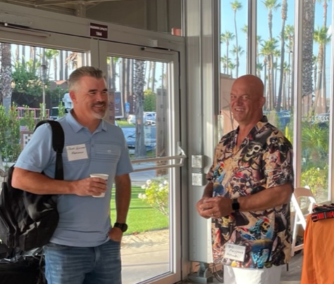
Yes, It’s a small world At the IUOTA Conference, you never know who you may run into.

Slide 8
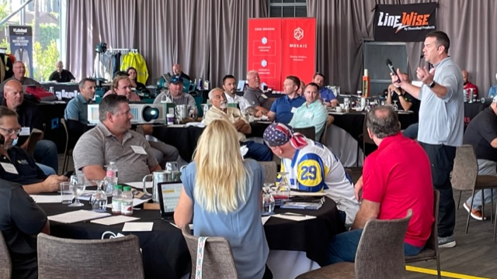
Presentations and open discussions were conducted on many topics.
PPE, Cover-Up, Grounding, and so much more.

Slide 9
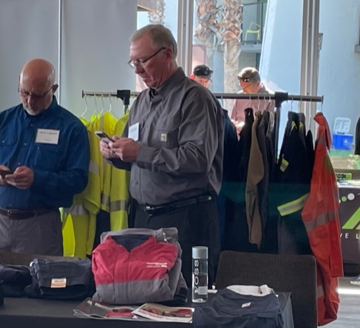
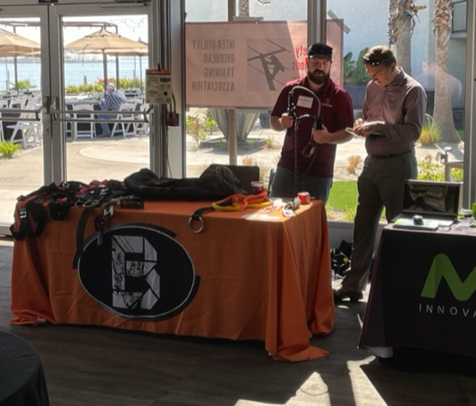
Issues back home still need our attention, and tool instructions go on all day.

Slide 10
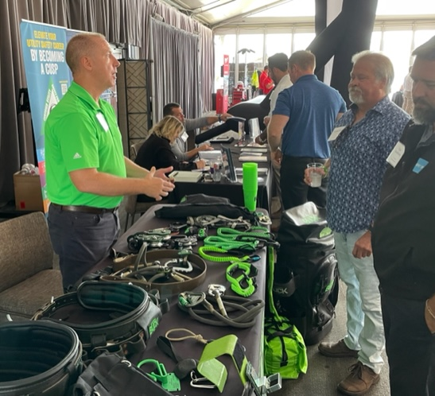
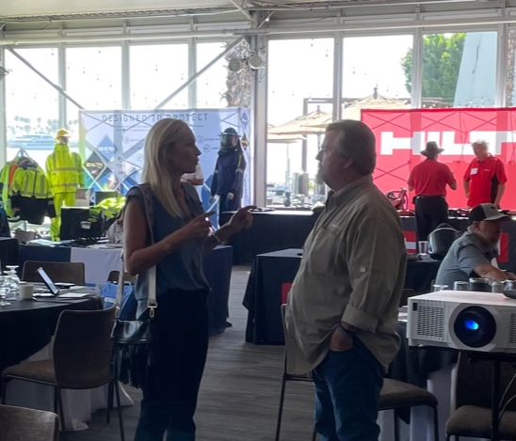
How it’s made, how it works, and how it helps to keep workers safe.
WOW!

Slide 11
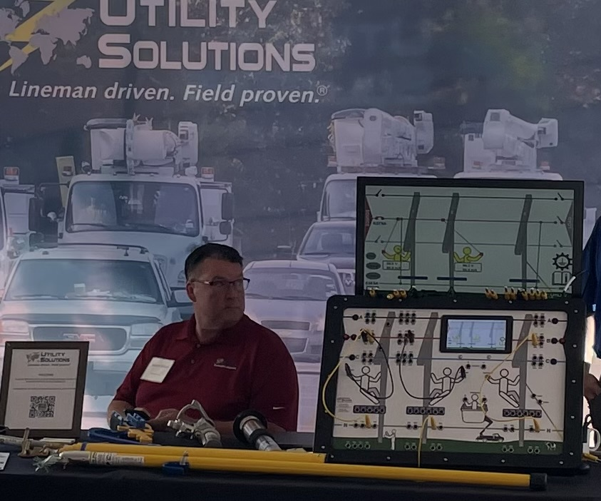
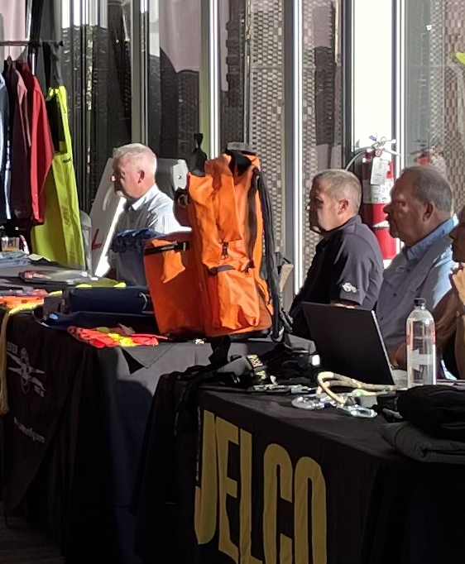
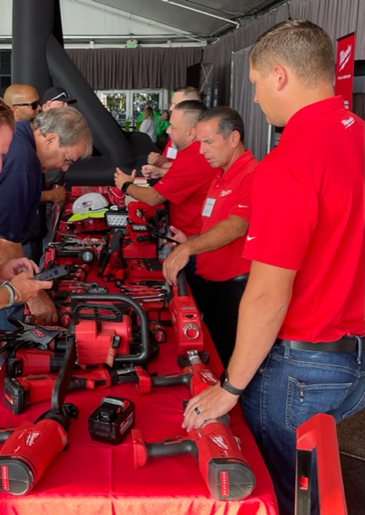
Tools and solutions that all focus on safety

Slide 12
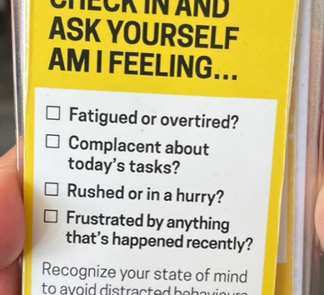
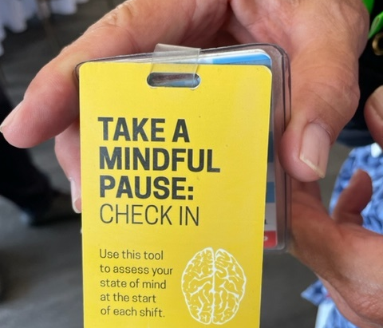
Take a mindful pause, are your employees ready for the days task.
At the IUOTA Conference, You share an issue, and someone has the answer.

Slide 13
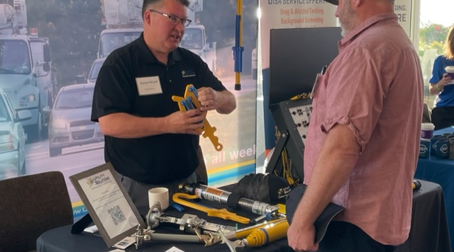
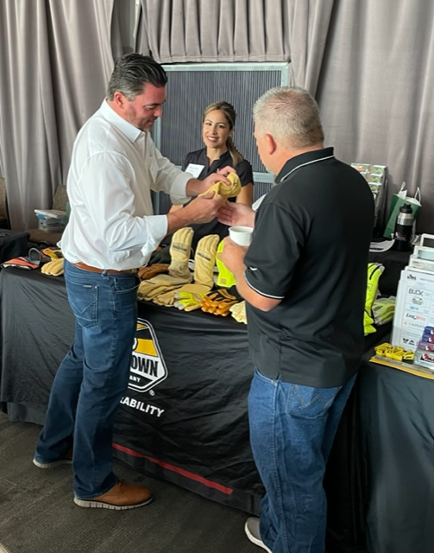
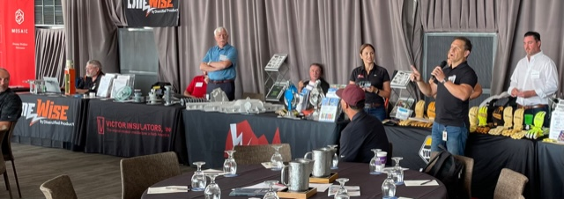
Demonstration after demonstration

Slide 14
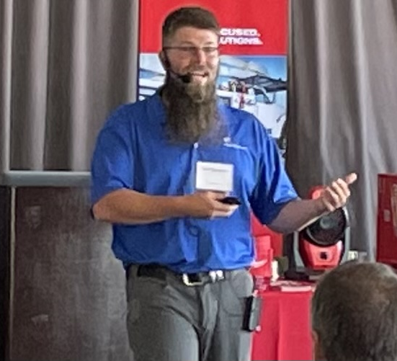
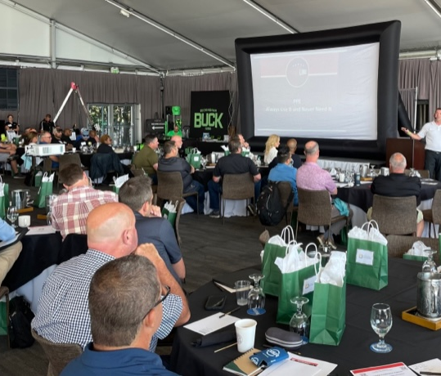
Grounding Why, Where, and When it’s needed.

Slide 15
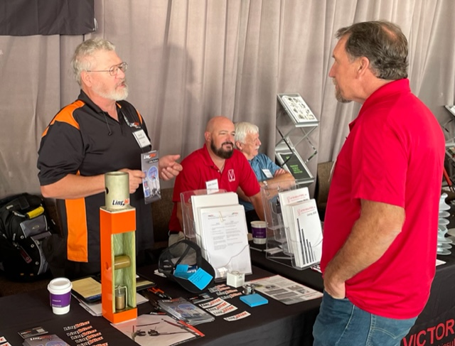

Slide 16
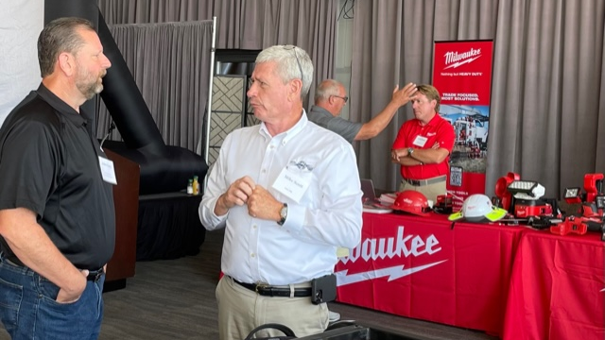
At the IUOTA Conference, it’s amazing what you can learn in a short conversation.

Slide 17
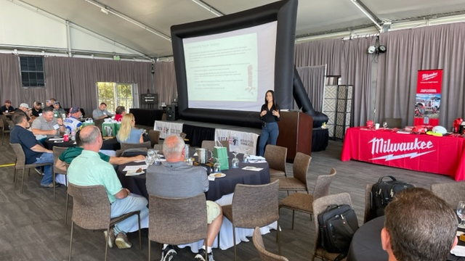
Carmen Lopez with SCE discussed Risk Based Safety and Human & Organizational Performance

Slide 18
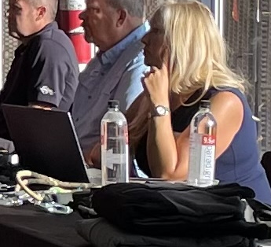
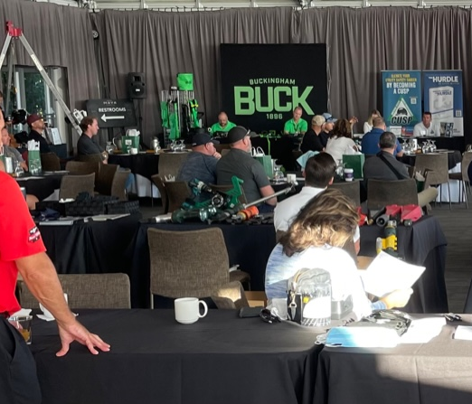
Kat Clemmons with JELCO, sponsored our social hour on Tuesday evening.

Slide 19
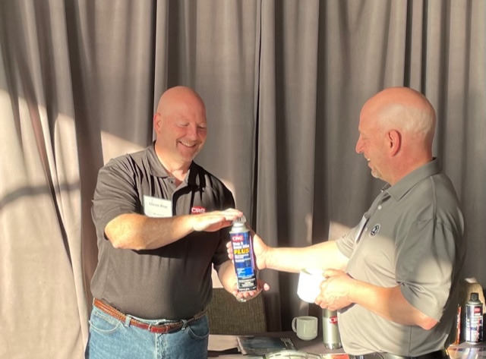
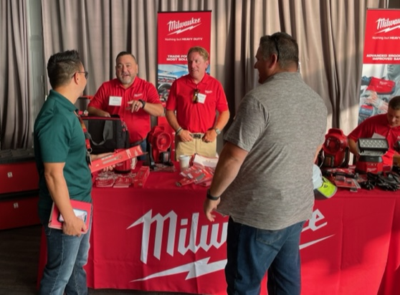
Discussions on safety related issues continued throughout the conference.

Slide 20
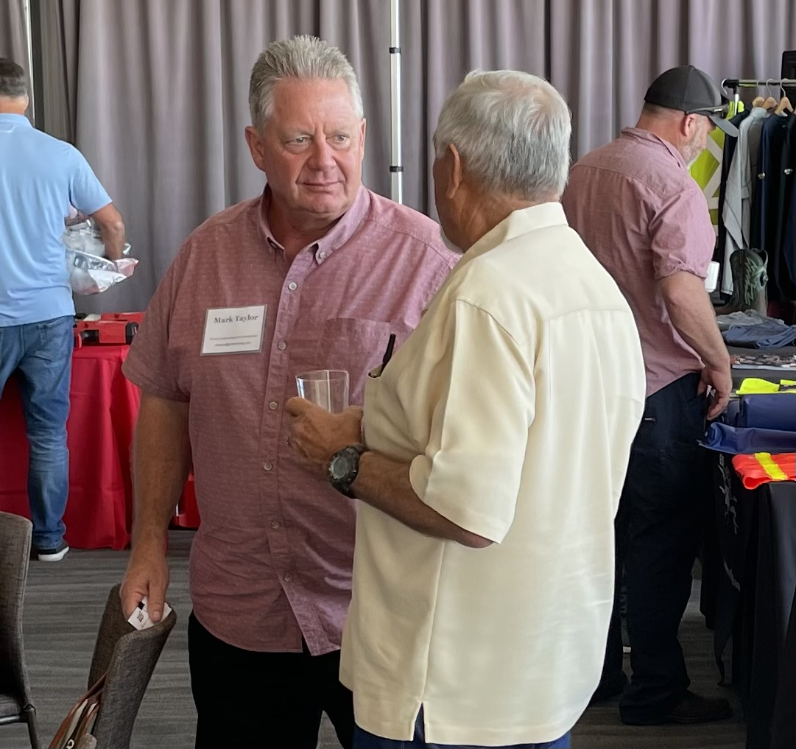
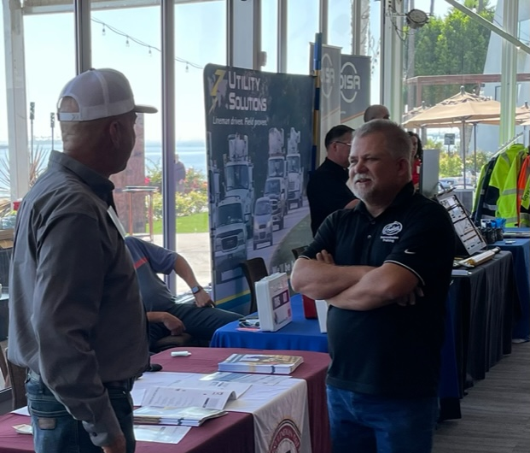
And before the conference is over, Mark and others are making plans and looking forward to next year’s conference. Hope to see everyone in 2023 The Conference is scheduled for the week of August 21st. in upstate New York

